Slide 2
7 lessons with a revision guide and an online end of unit test.
Ideal for EAL or weak ability students, focus on keywords and repetition of familiar skills.
Originally made for students at a British school in the UAE. An attempt has been made to keep definitions and concepts simple. As the lessons advance more analysis, creativity and input is steadily required from the students.

Slide 3
Lesson 5
Case study in Globalization:
United Arab Emirates

Slide 4
What will we do today?
1
2
3
4
Write down the LOs and today’s keywords in your COPY BOOK and GLOSSARY
Complete the table activity.
Find the keywords in the reward activity.
Listen to the explanation of tariffs and laws

Slide 5
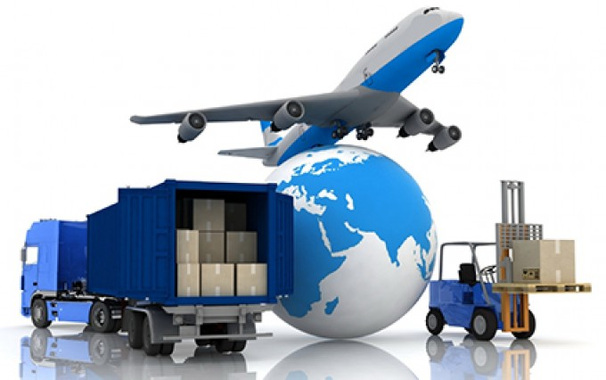
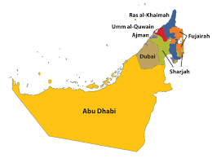
REMINDER: Two key words you need to know:
EXPORT: Products/Resources leave your country for sale.
IMPORT: Products/Resources enter your country for sale.
Can you think what your country might export and what it might import?

Slide 6
Learning Objectives:
I can describe two natural resources the UAE has sold.
I will explain the impact of globalization on the UAE’s history.
Keywords: Match them up and write them down! – 3 key words.
Farming
Natural Resources
Oil Well
A hole dug into the earth to get oil trapped underground.
Growing and producing food on the land or the sea.
Material naturally on the ground (or under it) that a country can sell.
Finished? Can you think of any examples natural resources in your country?

Slide 7
Learning Objectives:
I can describe two natural resources the UAE has sold.
I will explain the impact of globalization on the UAE’s history.
Keywords: Match them up and write them down! – 3 key words.
Farming
Natural Resources
Oil Well
Growing and producing food on the land or the sea.
Material naturally on the ground (or under it) that a country can sell.
A hole dug into the earth to get oil trapped underground.
Finished? Can you think of any examples natural resources in your country?

Slide 8
CASE STUDY IN GLOBALIZATION
THE UAE
The UAE is a very rich country.
How did it get rich?

Slide 9
CASE STUDY IN GLOBALIZATION
THE UAE
The UAE is a very rich country.
How did it get rich?
OIL

Slide 10
CASE STUDY IN GLOBALIZATION
THE UAE
But oil is not the first time the UAE has made money selling a NATURAL RESOURCE.
Between 1900 and 1920 the Emirates made lots of money selling pearls.

Slide 11
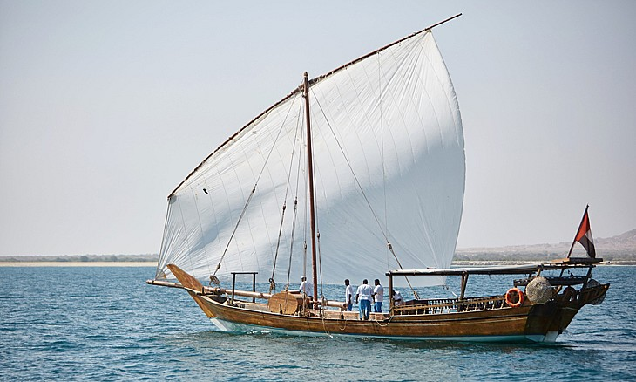
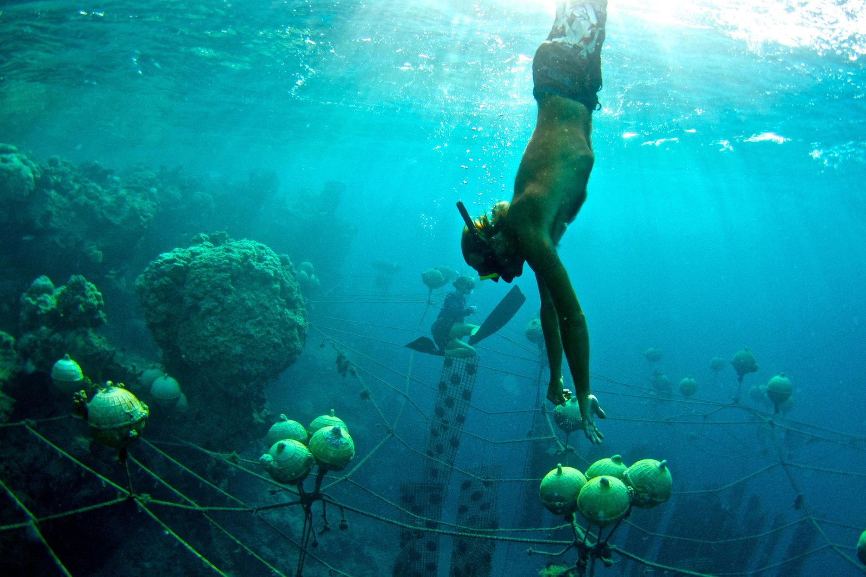
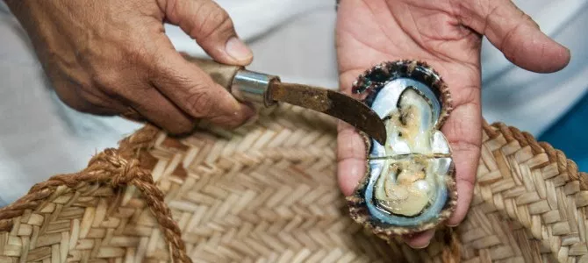
PEARL DIVING
The money made from pearls was one of the Emirate’s biggest money makers…
Until another country… Japan, found a way to make pearl’s cheaper than the UAE.

Slide 12
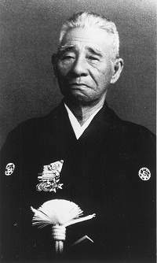
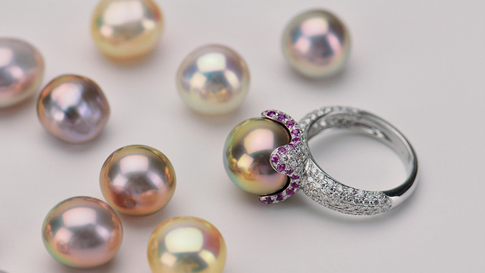
CULTURED PEARLS IN JAPAN
In 1916 this man, Tatsuhei Mise, from Japan invented a process of making pearls. He called them ‘cultured pearls’.
These were much cheaper and of a higher quality than pearls from the Emirates.

Slide 13
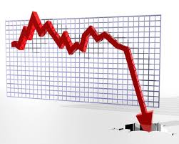
UNEMPLOYMENT
As a result the world stopped buying pearls from the Emirates and bought them from Japan instead.
This led to a lot of job losses in the Emirates and people became poor.
Until in 1930 they discovered… OIL!

Slide 14
COPY AND COMPLETE
In the early 1900s the Emirates made money from selling ____ to the world.
In 1916 the Japanese _________ a new way to make pearls cheaper, they were called ______ _______.
This caused the economy in the Emirates to do _____, until in the 1930s they discovered oil.
Selling oil has made the UAE very ___. But oil, like the pearls, will not last forever.
The UAE is looking for other _______ it can do well in so it can still be rich when people stop buying oil.
invented
industries
badly
Cultured pearls
pearls
rich

Slide 15
REWARD ACTIVITY
EXPORT
IMPORT
NATURAL
PEARLS
RESOURCES
OIL
OILWELL
FARMING

Slide 16
HAVE WE MET OUR LEARNING OBJECTIVES?
I can describe two natural resources the UAE has sold.
I will explain the impact of globalization on the UAE’s history.
DISCUSS THE ANSWERS
WITH YOUR PARTNER
SHARE WITH THE CLASS

