Slide 2
Digital Devices SOW
KS3/ICT iGCSE (Edexcel)
16 lessons with a revision guide and an online end of unit test.
Ideal for EAL or weak ability students, focus on keywords and repetition of familiar skills.
Originally made for students at a British school in the UAE. An attempt has been made to keep definitions and concepts simple. As the lessons advance more analysis, creativity and input is steadily required from the students.

Slide 3
Lesson 2
Phones and tablets
I can recognise the key vocabulary associated with phones.
I will be able to describe the benefits of a smart phone over a standard phone.

Slide 4
What will we do today?
1
2
3
4
Discuss the three key words and write them in your book. Match them to the logo.
List the microprocessors in your home.
Feedback to the teacher what you have learn today.
Write down the LOs

Slide 5
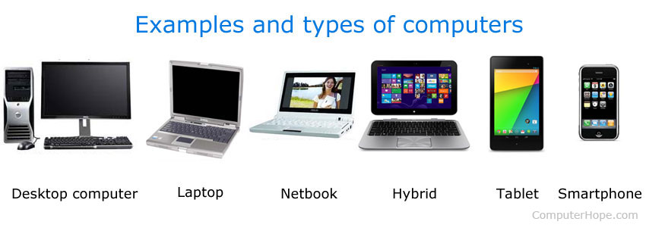
Can you name the different types?

Slide 6
Can you name the different types?

Slide 7
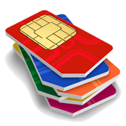
I can recognise the key vocabulary associated with phones.
I can describe the benefits of a smart phone over a standard phone.
TASK: Match up the picture, keyword and definitions – write them down.
WIFI
APPS
Stands for Subscriber Identity Module. Lets the phone network know who you are and with phone provider (company you use).
STRETCH: Why do some phones come with an ‘emergency button?’
Stands for Wireless Fidelity. Allows devices to connect to the internet using radio signals instead of wires.
SIM
Stands for applications. These are the computer programs a phone or tablet can run.

Slide 8
I can recognise the key vocabulary associated with phones.
I can describe the benefits of a smart phone over a standard phone.
TASK: Match up the picture, keyword and definitions – write them down.
SIM
Stands for Subscriber Identity Module. Lets the phone network know who you are and with phone provider (company you use).
STRETCH: Why do some phones come with an ‘emergency button?’
APPS
Stands for Wireless Fidelity. Allows devices to connect to the internet using radio signals instead of wires.
WIFI
Stands for applications. These are the computer programs a phone or tablet can run.

Slide 9
Research Task: What are the benefits of smart phones versus tablets?
Advantages of smartphones | Advantages of tablets
Complete the table by adding in your ideas on what the advantages of each are.

Slide 10
Research Task: What are the benefits of smart phones versus tablets?
Advantages of smartphones | Advantages of tablets
More portable Can make calls Better battery life (sometimes) | Larger screen Better sound More durable (will break less easily)
Complete the table by adding in your ideas on what the advantages of each are.

Slide 11
HAVE WE MET OUR LEARNING OBJECTIVES?
I can recognise the key vocabulary associated with phones.
I will be able to describe the benefits of a smart phone over a standard phone.
DISCUSS THE ANSWERS
WITH YOUR PARTNER
SHARE WITH THE CLASS

