Slide 1



Slide 2

PREMIUM
INDUSTRIAL REVOLUTION
14 lessons with a revision guide and an online end of unit test.
Each lesson includes all resources ready to print, Quick Start instructions, stretch activities, differentiated support materials and lesson specific EAL support sheets.
For more information on the pedagogical thinking behind the SOW see the related
Cardinal's Corner blog post..

Slide 3
Quick Start Guide:
Pupils lining up at the door? Not had your coffee yet? Follow our quick start guide…
Lesson Prep
Print the six factors
High ability slide 12
Low ability slide 13
Print the factor slide 1
(or get the pupils to draw it u)
Plan differentiated questioning using blooms taxonomy (see end of slide)
Print the differentiated sentence starter sheet on slide 14
Print the EAL assistance sheet if applicable.
Lesson Flow
Discuss the information on slide 4
Groups to answer each question on each of the factors in turn.
Think/Pair/Share mini-plenary
Time traveller report write up (see slide for structure)
Post it notes on factor board plenary.

Slide 4

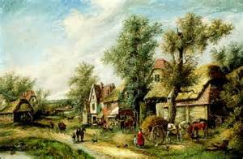
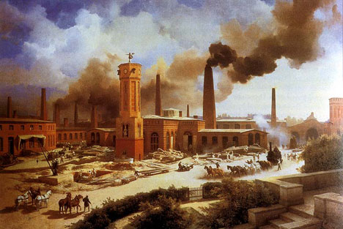
What could cause such dramatic changes?
What does population mean?
How many times has population increased?
Industrial Revolution:
Population boom!
1750
1900
Population = 7 million
Population = 37 million
People living in towns = 13%
People living in towns = 87%

Slide 5
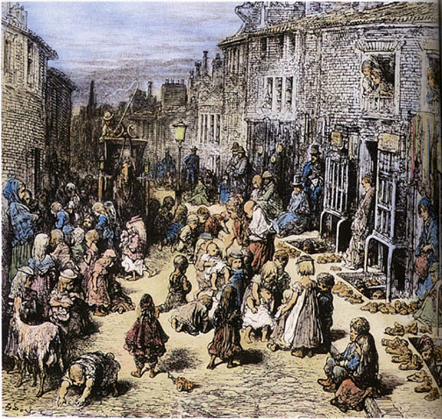
TASK: What factors led to the increase in population and the move to the cities?.
In pairs read through the six factors and decide why this factor would have led to a population boom.
Answer the three questions on the next slide for each factor.

Slide 6
Factors that led to a population boom during the Industrial Revolution.
What was it called?
How did it work?
It worked by….
What was the effect on the population and where they lived?
This helped increase population because…
Finished?
Can you categorise these factors?
Which are the most important? Rank them in order, most important to least.
Explain why you think so.
Notes:
Have up on screen for them to copy out in books.

Slide 7

Spot check:
How did these changes lead to:
More people?
Larger cities?
Think, tell a partner, share with the class.

Slide 8

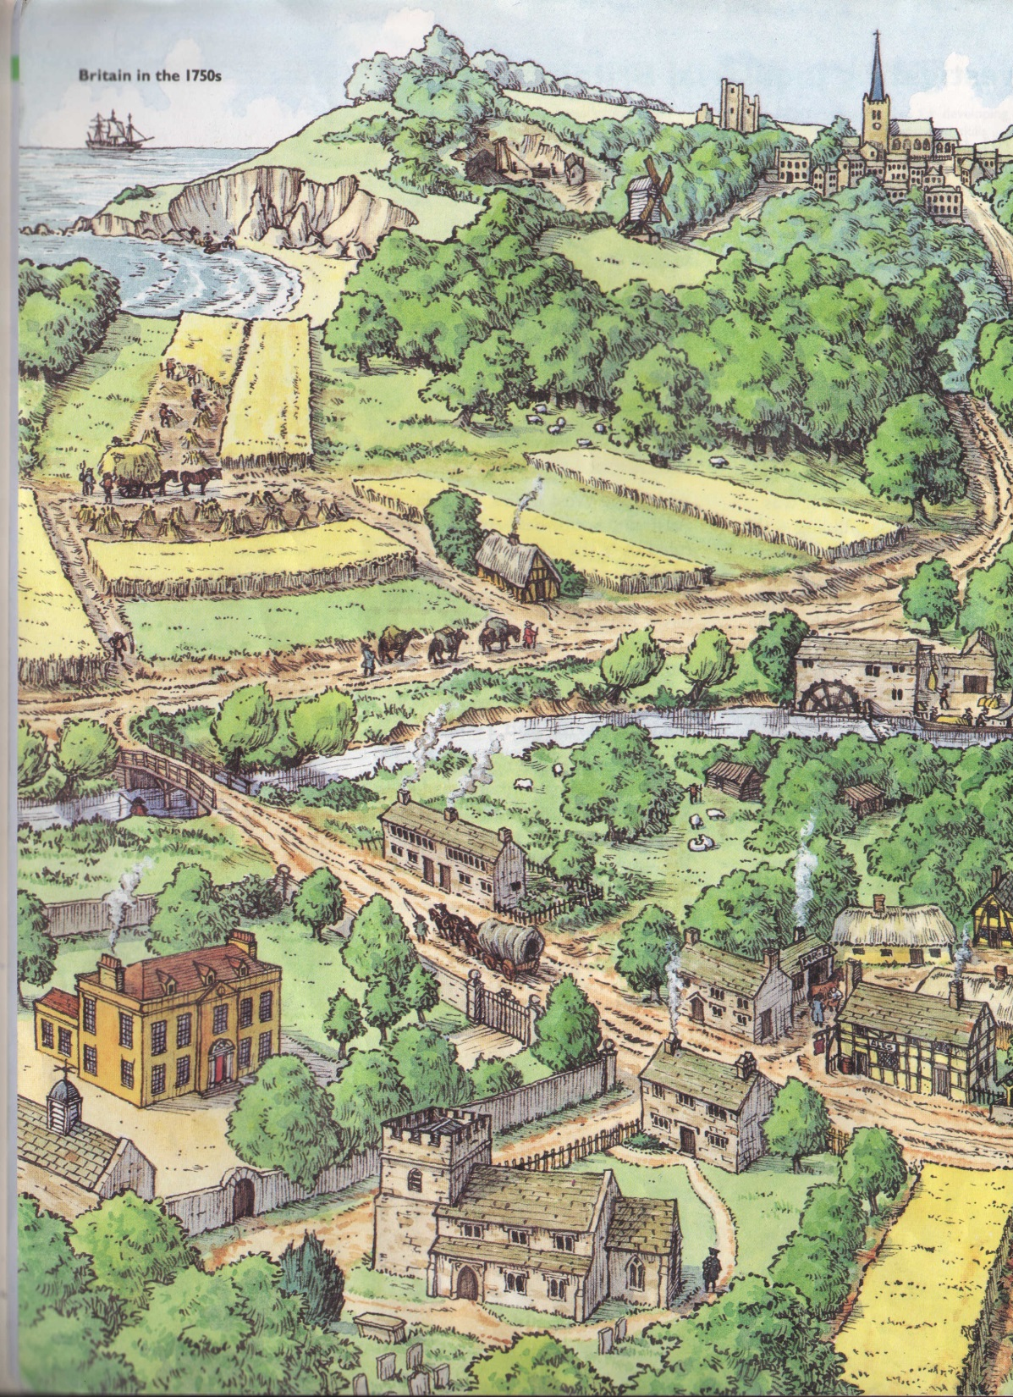
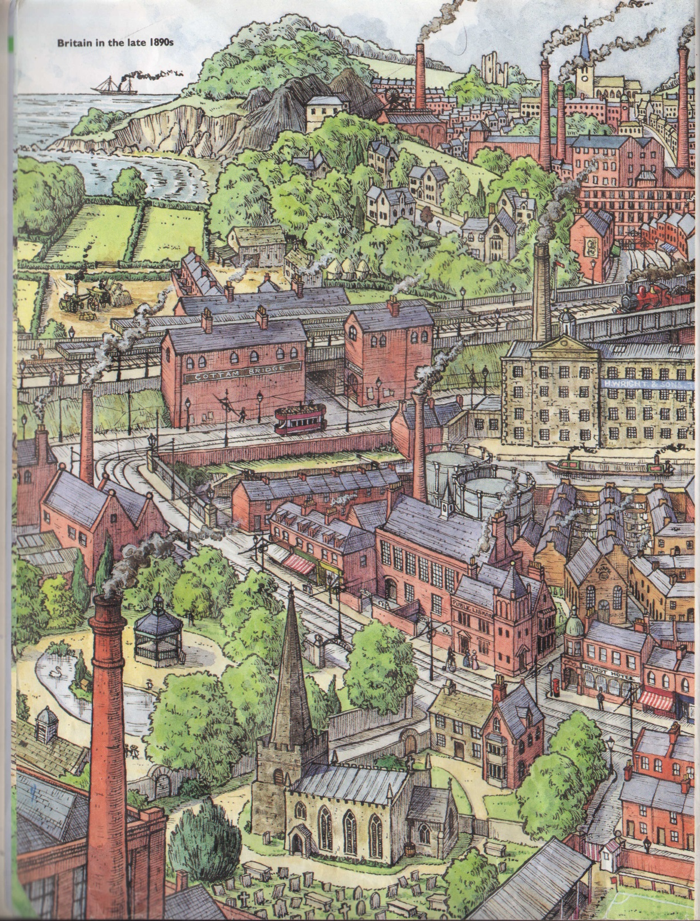

Time Traveller report!
Imagine you have visited Britain, 1750 in the TARDIS. You get out, talk to the people and see how they live.
You then get back into the TARDIS and visit Britain, 1900.
What differences do you notice?
Why have they happened?
What impact have they had?
Extra challenge =
Do not use the words:
Because, work, better, worse, more.
The first thing I noticed in 1900 was…
I began to investigate why this might have happened and discovered that…
I asked the locals what impact this had had on their lives and was told that…

Slide 9

Which change was the most important?
Seed drill
Factories
Crop rotation
Small pox vaccine
Sewers
Selective breeding
Justify
your
answer
Notes:
Either a hands up quiz with spot questions or post it notes on which they all write a justification.

Slide 10
RESOURCES

Slide 11
Factor 1:
Evidence:
Effect on population:
Reason 1:
Evidence:
Effect on population:
Factor 3:
Evidence:
Effect on population:
Factor 2:
Evidence:
Effect on population:
Factors that led to a population boom during the Industrial Revolution.
Factor 4:
Evidence:
Effect on population:
Factor 5:
Evidence:
Effect on population:
Factor 6:
Evidence:
Effect on population:
Notes:
Either print to complete or have up on screen for them to copy out in books.

Slide 12
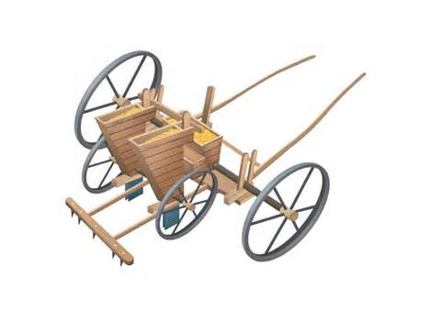


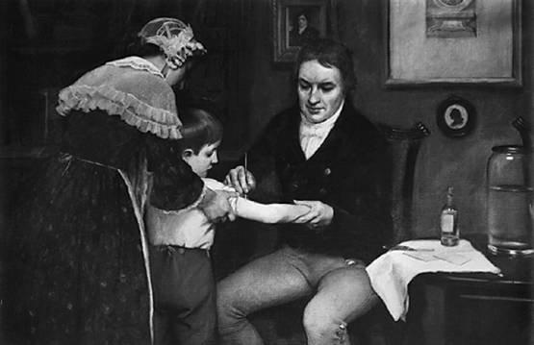


The seed drill was built by a farmer called Jethro Tull. It was designed to be pulled by a horse and would plant seeds quickly in neat rows. This was far more effective than throwing seeds onto the field. It let farmers grow and look after crops more efficiently.
Factories began to be built in Britain from around 1770. They produced more goods, more quickly which let more people buy their goods. The jobs they created attracted thousands of people into cities to work in them.
Four field crop rotation was invented by a man called Charles ‘Turnip’ Townsend. It was a system that let famers get the most of their land – after the harvest livestock would be let in which would help fertilise the land for the next crop.
In 1796 Edward Jenner discovered a way to inoculate people against the deadly killer smallpox! This saved hundreds of thousands of lives, especially after 1830 when it become compulsory for people to have it!
Sewers were built in the fast growing cities. This removed waste from homes and business safely. They allowed streets to remain clean and stop diseases spreading. By making the cities safer places to live the sewage systems allowed more people to move there.
Farmers from the 1750s began to ‘selectively breed’ their animals. This meant that they picked the biggest animals to breed so their children would be bigger, healthier and more useful to the farmer. This simple technique made meat far more available at markets around the country.
Notes:
High: alternatively use the sheet but work from p10 of Industry, Reform and Empire. There are 11 reasons on that page so they could drop those they think are least important.

Slide 13
Jethro Tull invented the seed drill. It let farmers plant crops more effectively. There was more food as a result.
Factories were built in Britain from 1770 . They made things faster and cheaper than before. This made people move to the cities for jobs.
A system of crop rotation was invented by a name with the nickname “Turnip Townsend”. His system let crops grow much faster.
In 1796 a man called Edward Jenner discovered a vaccination for the deadly Small Pox. It saved millions of lives.
Sewers took away all the waste from the cities making them much nicer places to live.
Farmers began to breed much bigger livestock (cows, sheep etc) that meant that farmers had more meat to sell to market.
Notes:
low

Slide 14
It was called…
It worked by…
It increased population and made people move to the cities because….
It was called…
It worked by…
It increased population and made people move to the cities because….
It was called…
It worked by…
It increased population and made people move to the cities because….
Notes:
Lower.

Slide 15
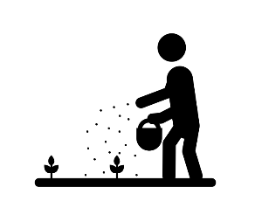


EAL ASSISSTANCE SHEET
1. Can you match the words to the correct image?
Crops
Seeds
Vaccine
Challenge: Write a paragraph using all of the words above. Make sure it makes sense!

Slide 16
Lesson/Topic | Learning Objectives | Learning episodes | Key Words | Resources | Assessment
2. Population boom during the Ind Rev. | Identify the key changes to population during the Industrial Revolution. Describe the key changes to population during the Industrial Revolution. Explain the key changes that occurred to population during the Ind Rev. | 1. Think, pair, share responses to the graphic showing demographic change and urbanisation. 2. Pupils use the empty spider diagram (or draw their own) to fill in from the factors sheet. Factor sheet can be given directly to students in groups, it could be cut up and placed around sides of room or it could be printed off once and used as a teacher model with pupils coming up to look at it before repeating notes to a partner. 3. Spot check understanding. Vital that pupils have understood what the factors are and how they would have impacted population. 4. Time traveller exercise – pupils explaining the differences between 1750 and 1900 and why they have occurred. 5. Pupils to vote for the most important factor with a post it note that also justifies their choice. | Population Factories Sewers Innoculation Vaccination | PowerPoint: X>Hums>History>Resources>Year 8> Ind Rev>Lesson 2>Population boom.ppt Spider diagram and factors can be printed off as separate sheets if desirable. Post it notes for plenary. | Teacher assessment. paired work Group work verbal and written responses
Differentiation |  | Population factor sheet has been differentiated for SEN. Stretch questioning on PowerPoint.
Literacy Opportunities |  | Banned words to promote a wider use of vocabulary.
Numeracy Opportunities |  | Pupils can be asked how many times greater the population/urbanisation has increased.
SMSC Opportunities
Homework |  | -

Slide 17
Imagine you are a time traveller visiting England in 1900. The last time you were there it was 1750. Imagine you begin to ask the people what has happened to bring about so much change in such a short time.
Explain how things have changed.
Include:
Why people moved home.
The jobs people do.
The machines and inventions they use to do them.
The general appearance and health of the people.
Are people any happier?
The first change I noticed in 1900 was…
I asked how this happened and was told …
It looks like this change was important because…
Extra challenge =
Do not use the words:
Because, work, better, worse, more.
Notes:
draft slide.

Slide 18


