Slide 2
Digital Devices SOW
KS3/ICT iGCSE (Edexcel)
Get all 16 lessons with a revision guide and an online end of unit test at www.wolseyacademy.com
Ideal for EAL or weak ability students, focus on keywords and repetition of familiar skills.
Originally made for students at a British school in the UAE. An attempt has been made to keep definitions and concepts simple. As the lessons advance more analysis, creativity and input is steadily required from the students.

Slide 3
ALL 67 KEYWORDS FROM DIGITAL DEVICES EAL SOW

Slide 4
On a computer screen this is a small coloured square that makes up an image. The more pixels the higher quality the picture.
Pixel
Resolution
The number of pixels used to display an image.

Slide 5
When an image is stretched too much and you can see the pixels (it looks ‘blocky’).
Pixelated
Watching or listening to a file as it is being downloaded from the internet. It is not saved on your computer.
Stream

Slide 6
Stands for Universal Serial Bus. It is a standard connection for a wire between electrical devices.
USB
Sometimes called a STB. A digital device that sends audiovisual signals from a television broadcaster to your television.
Set Top Box

Slide 7
A figure that represents a person inside a computer game or other virtual environment.
Avatar
Different countries have different age ratings for games and movies. Anyone under this age is not allowed to play or watch it.
Age Ratings

Slide 8
Virtual Reality
An immersive experience which fills the user’s audio-visual senses with information and gives the appearance of a real world.
Portable Devices
A small device designed to be carried in your pocktet. E.g. Gameboy, ipod, smart phone.

Slide 9
Flash
Memory
A type of data storage that holds electrical data in tiny electrical cells. It can be shaken and it will still work.
Set Top Boxes that allow you to run video games and other interactive programs. E.g. PlayStation, XBox
Games Consoles

Slide 10
A satellite navigation system designed by the European Union. It is more accurate than GPS. It can locate you to within a few centimeters.
Galileo
GPS (Global Positioning System)
Global Position Systems (GPS) is a satellite navigation system designed by the USA. It can locate you to within a few metres.

Slide 11
A name given to any satellite navigation system or device that provides you with access to one. For example many cars have a Sat Nav and most smart phones.
Sat-Nav
A home that includes devices that are controlled by an app on a smart phone or other device. E.g. lighting, temperature, fridges and washing machines.
Smart Home

Slide 12
A device that goes into space and into Earth’s orbit. It picks up signals from one part of Earth and sends them quickly to another. (It ‘relays’ the signals).
Satellites
When you find out where you are and how to get directions to where you want to go.
Navigation

Slide 13
Multifunctional Device
A device that can perform different functions. E.g. A smartphone can play music, be a navigation aid, make phone calls etc.
When new devices do more and more functions all in one, replacing the need for lots of devices.
Convergence

Slide 14
The most important function a device can do. E.g. The primary function of a smartphone is to make phone calls, everything else is secondary.
Primary function
Smart phones have got larger in size as their functions have increased. Some are so big they look like small tablets. They are called ‘Phablets’.
Phablets

Slide 15
Fitness Tracker
An application on a smartphone that allows the user to track their speed, distance run, calories burnt etc.

Slide 16
How good a device is at connecting to other devices and computer networks (including the Internet).
Connectivity
The ‘engine’ of a computer. This is a microchip that performs most of the calculations and processes the data to run the computer.
Processor

Slide 17
Random Access Memory. This microchip in a computer stores data the processor needs when making calculations. The data is lost when the computer is switched off.
RAM
Virtual Memory
This is storage in the computer that the processor will use if the RAM runs out of space.

Slide 18
Data that represents a document, image, video, audio clip or a database.
File
Instructions written in computer code that when ‘run’ make the computer perform a task or function
Program

Slide 19
A system that allows users to interact with a device.
User Interface
A system that uses windows, icons, menus and a pointer.
WIMP

Slide 20
A system that uses small icons to represent programs and files. E.g. Windows.
A system that uses small icons to represent programs and files. E.g. Windows.
Graphical User Interface (GUI)

Slide 21
A system that uses small icons to represent programs and files. E.g. Windows.
Personal Identification Number. A unique number that allows a user to access their data in a computer system. Eg. A bank or to unlock a phone.
PIN

Slide 22
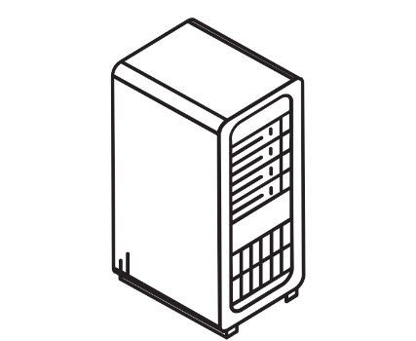
A pheripheral device that sends data to the computer. E.g. A keyboard, mouse, scanner.
Input
A pheripheral device that does something with data from the computer. E.g. A monitor, speakers, printer.
Output
Notes:
Computer by matthew hall from the Noun Project

Slide 23
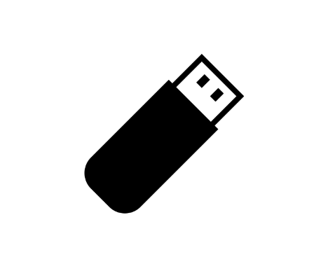
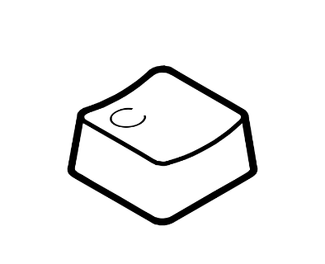
A device that takes data from the computer and stores it for future use. E.g. a USB flash drive, an external hard drive.
Storage
A combination of keys on a keyboard that perform a certain function. E.g. Ctrl+S = Save File. Ctrl+C = Copy.
Shortcut
Notes:
Flash Drive by Setyo Ari Wibowo from the Noun Project
C by Pedro Martínez from the Noun Project

Slide 24
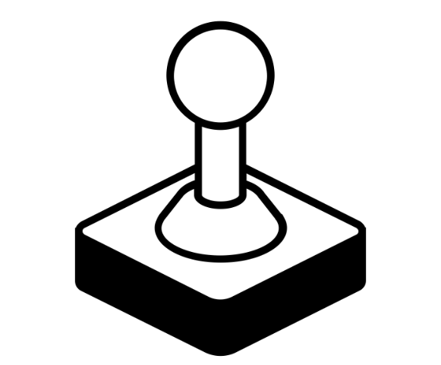
An icon on screen (normally an arrow) that is used to select objects. Normally controlled by a mouse or a track pad.
Pointer
A lever used to control an icon on a screen or a character in a video game.
Joystick
Notes:
mouse pointer by Jyoti Vyas from the Noun Project
joystick by mikicon from the Noun Project

Slide 25
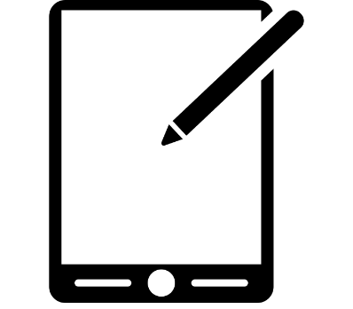
Stylus
A pen shaped device that allows the user to enter data onto a computer screen.
Characters
A letter or symbol on a computer.
Notes:
phablet by Hopkins from the Noun Project
Barcode by sandra from the Noun Project

Slide 26
Stylus
A pen shaped device that allows the user to enter data onto a computer screen.
A pattern of lines and gaps that can be read by a computer scanner. It links to information – usually about a product, e.g. price and stock.
Barcode
Notes:
phablet by Hopkins from the Noun Project
Barcode by sandra from the Noun Project

Slide 27
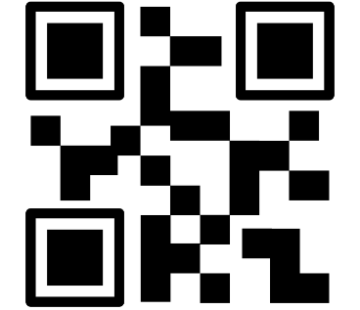
A pattern of lines and gaps that can be read by a computer scanner. It links to information – usually about a product, e.g. price and stock.
Barcode
Matrix Code (QR CODE)
They are like bar codes but can hold more information. They can also be scanned from any angle.
Notes:
Barcode by sandra from the Noun Project

Slide 28
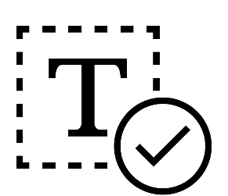
Plain Text
Data that shows basic text. There is no formatting or any other data like colour, size etc.
Data that includes text that includes and the text size, colour, font etc.
Formatted Text
Notes:
txt by Matthew Weatherall from the Noun Project
text by Hea Poh Lin from the Noun Project

Slide 29
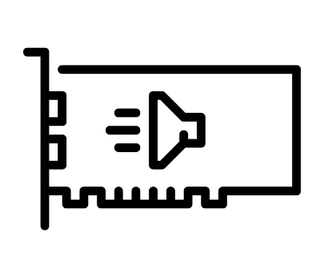
Sound
Card
A device added or built into the computer to allow it to play and record audio (sound).
Stands for Voice over Internet Protocol. It is the software that allows people to speak to each other over the Internet. It will support things like Skype and WhatsApp call.
VoIP
Notes:
Sound Card by Denis Shum
online call by I Putu Kharismayadi from the Noun Project
aylov from the Noun Project

Slide 30
Touching the screen causes pressure which pushes two layers together – completing an electric circuit. They are difficult to read because of the multiple layers.
Resistive Touchscreen
Touching the screen causes a small amount of electric charge to flow between your finger and the screen. Humans conduct electricity – if you are wearing gloves it will not work.
Capacitive Touchscreen
Notes:
Finger by Vectors Market from the Noun Project

Slide 31
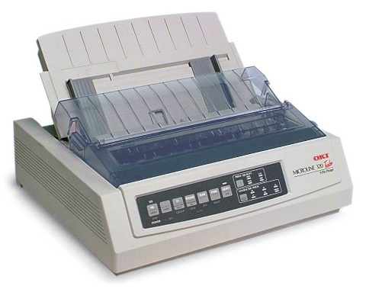
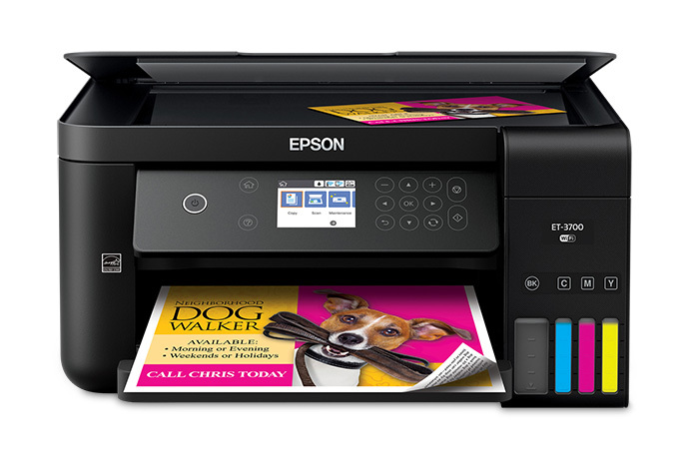
A system that uses small icons to represent programs and files. E.g. Windows.
Dot Matrix Printer
A ribbon of ink is put over the paper and the printer will ‘hit’ the ribbon to make a print of the paper. Very noisy. An older method.
A system that uses small icons to represent programs and files. E.g. Windows.
Ink is held in four different containers (cartridges). Black, Yellow, Cyan and Magenta. These colours are sprayed onto the page in tiny dots to make a picture.
Inkjet
Printer

Slide 32
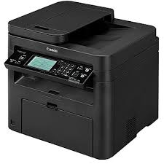
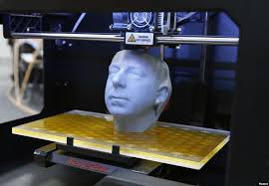
A system that uses small icons to represent programs and files. E.g. Windows.
The paper is passed over a drum. A laser above the drum makes parts of the drum electronically charged. The ink is then attracted to those parts – making an image.
Laser
Printers
A system that uses small icons to represent programs and files. E.g. Windows.
3D Printing
A 3D printer uses a liquid material (usually plastic). The material is injected out one layer at a time. The model slowly builds up layer by layer until it has produced the shape you want.

Slide 33
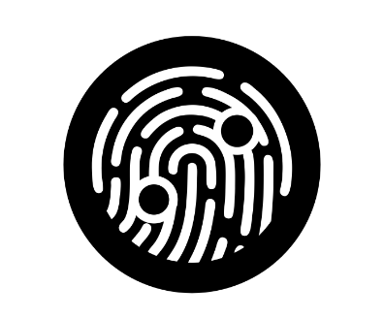
A system that uses small icons to represent programs and files. E.g. Windows.
Personal Identification Number. A unique number that allows a user to access their data in a computer system. Eg. A bank or to unlock a phone.
PIN
A system that uses small icons to represent programs and files. E.g. Windows.
When a computer identifies you from something unique to you. E.g. A fingerprint, face, voice, iris etc.
Biometric
Notes:
biometric by priyanka from the Noun Project

Slide 34
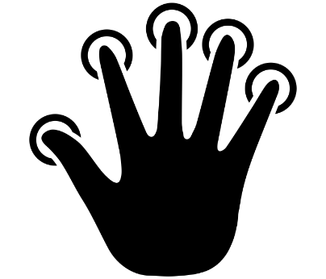
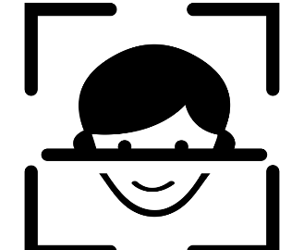
A system that uses small icons to represent programs and files. E.g. Windows.
Fingerprint
Recognition
Scanners identify the unique pattern on your fingertips to identify you.
A system that uses small icons to represent programs and files. E.g. Windows.
Facial
Recognition
Scanners identify the unique structure of the human face to identify you.
Notes:
Fingerprint by Delwar Hossain from the Noun Project
Facial Recognition by Delwar Hossain from the Noun Project

Slide 35
A system that uses small icons to represent programs and files. E.g. Windows.
Voice
Recognition
Scanners identify the unique sound of your voice to identify you.
A system that uses small icons to represent programs and files. E.g. Windows.
Iris
Recognition
Scanners identify the unique patterns of veins in your eye to identify you.

Slide 36
A system that uses small icons to represent programs and files. E.g. Windows.
Tricking (deceiving) other people to get access to their identification to allow someone to access their data.
Fraud
A system that uses small icons to represent programs and files. E.g. Windows.
Near Field Communication
A microchip in a device or credit card can contain a unique ID code that emits to other nearby devices. E.g. A contactless payment with a credit card.

Slide 37
A system that uses small icons to represent programs and files. E.g. Windows.
How much data something can store, usually measured in how many Bytes (e.g. 1 KB or 1 TB)
Capacity
A system that uses small icons to represent programs and files. E.g. Windows.
When data is stored permanently and is not lost when you turn off the power.
Non-Volatile

Slide 38
A system that uses small icons to represent programs and files. E.g. Windows.
Bit
A single ‘bit’ of binary computer code – e.g. a 1 or a 0.
A system that uses small icons to represent programs and files. E.g. Windows.
8 ‘bits’ make a Byte.
e.g. 11001100
Byte

