Slide 2
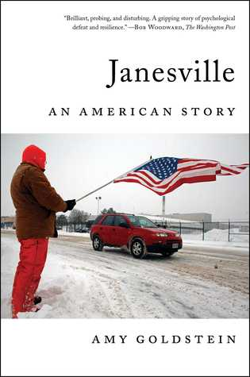
Janesville: An American Story
by Amy Goldstein
(2017)
See Cardinal’s Corner Blog Post.

Slide 3
What will we do today?
1
2
3
4
Write down the LOs and today’s keywords in your COPY BOOK and GLOSSARY
Complete the cloze activity.
Find the keywords in the reward activity.
Listen to the explanation of Globalization’s negatives

Slide 4
Learning Objectives:
I can describe some negatives of globalization.
I will explain how these can cause problems.
Keywords: Match them up and write them down! – 3 key words.
Unemployed
When someone has to learn new skills to find different work if they are unemployed.
When someone losses their job because the company they worked for shuts down.
Outsourcing
Retraining
When companies move jobs to a different country because they can pay lower wages.
Finished? Can you think of any examples of jobs that might have moved from rich countries to poorer countries?

Slide 5
Learning Objectives:
I can describe some negatives of globalization.
I will explain how these can cause problems.
Keywords: Match them up and write them down! – 3 key words.
Unemployed
When someone has to learn new skills to find different work if they are unemployed.
When someone losses their job because the company they worked for shuts down.
Outsourcing
Retraining
When companies move jobs to a different country because they can pay lower wages.
Finished? Can you think of any examples of jobs that might have moved from rich countries to poorer countries?

Slide 6
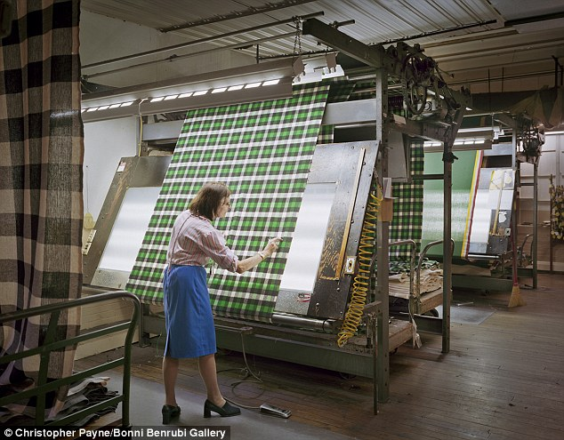
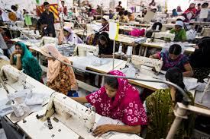
Why would a clothing company move their factory from Britain to Bangladesh??
?
BRITAIN:
AVERAGE WAGE
135000AED a YEAR.
BANGLADESH:
AVERAGE WAGE
3600AED a YEAR.
This is called outsourcing.

Slide 7
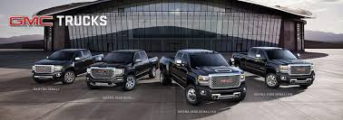
CASE STUDY: JANESVILLE, USA
Janesville was a rich town in the USA. It was where GMC trucks were made. It gave thousands of people highly paid jobs.

Slide 8
CASE STUDY: JANESVILLE, USA
But in 2009 GMC stopped making cars in Janesville and closed the factory. It was not selling as many cars any more as Americans were buying cheaper and better cars from Asia (e.g. Toyota/Nissan).

Slide 9
CASE STUDY: JANESVILLE, USA
When people lose their jobs at the factory it hurt the whole town.
Factory workers did not have money to go to the shops or restaurants. So they had to shut down too.
In 2016 people were so angry that many people voted for Donald Trump because he promised to bring factory jobs back to America.
https://www.youtube.com/watch?v=Y5yVEsPbIXU
Why might it be difficult to bring factory jobs back to America?

Slide 10
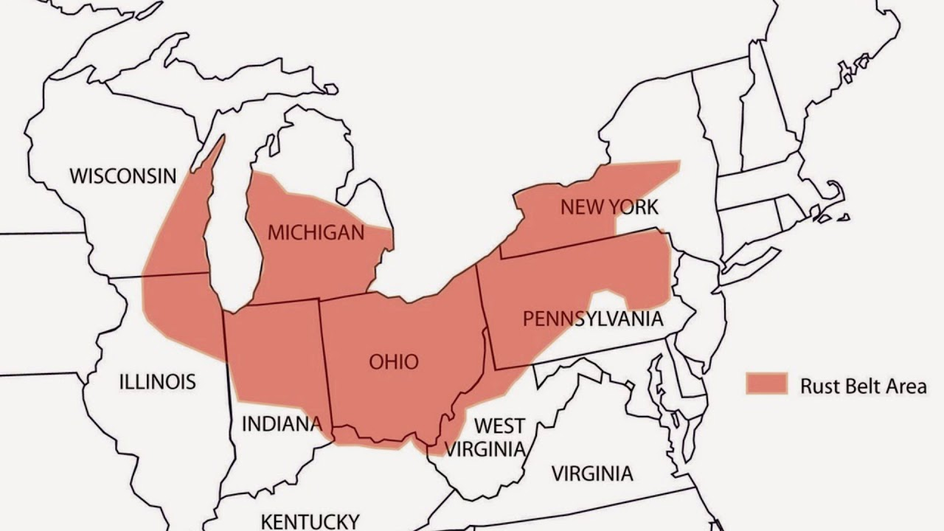
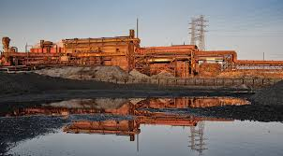
This has happened across large parts of the USA, especially an area called ‘The Rust Belt’.
This area was once a very rich area full of factories and good jobs. This area would export vehicles and goods all over the world. Today many of these are closed and are left ‘rusting’ – hence the ‘Rust Belt’.

Slide 11
Copy and complete.
Globalization can have a negative effect on people in some ____ countries.
When companies move their _______ to cheaper countries the people in the rich country lose their _____.
This also means that shops and restaurants that used to sell to the factory workers will also have to close down. This is what happened in ________, USA.
This has been a problem across the USA, especially in an area known as the _____ belt.
JANESVILLE
JOBS
RICH
FACTORIES
RUST
Finished? What do you think the workers in Janesville will have to do to try and find new jobs?

Slide 12
REWARD ACTIVITY
BANGLADESH
AMERICA
BRITAIN
JOBS
TRADE
ASIA
COMPETITION
OUTSOURCING
UNEMPLOYED
FACTORY
RETRAINING

Slide 13
HAVE WE MET OUR LEARNING OBJECTIVES?
I can describe some negatives of globalization.
I can explain how these can cause problems.
DISCUSS THE ANSWERS
WITH YOUR PARTNER
SHARE WITH THE CLASS

