Slide 1
Quick Start Guide:
Pupils lining up at the door? Not had your coffee yet?
Follow our quick start guide…
1
Print and copy the source packs to fit your class size (slides 15-22)
2
Check these links are valid and have them ready to play in browser:
https://www.youtube.com/watch?v=82RTzi5Vt7w&t=134s
3
Put up title slide, meet students at door and instruct them to begin the Literacy/Numeracy settler task.

Slide 2
Operation Overlord and D-Day, 1944
Warm Up
LO: Examine the factors behind the Allies’ success in the Normandy campaign.
Amphibious: When military forces attack the land from the sea. (add to glossary in back of book (BOB)).
Knowledge
Check
“You are about to embark upon the Great Crusade, towards which we have striven these many months.
The eyes of the world are upon you. The hopes and prayers of liberty-loving people everywhere match with you.”
Q: These words are from the US General Eisenhower’s speech before D-Day.
What can we learn from it?
SPAG?
Copy and correct.
The Normandy landings where the Amphibious operations on tuesday, 6 June 1944 of the allied invasion of normandy in operation overlord during World War II.
Numeracy:
156,000 Allied troops were landed on the Normandy beaches during Operation Overlord. 10,000 of these became casualties in the fighting.
What percentage of the landing force became casualties?
Write
Peer
Homework
CHECK
Finished? – Try this..
What dangers are there in launching an amphibious attack?
Notes:
Answer to numeracy: 6.4%

Slide 3
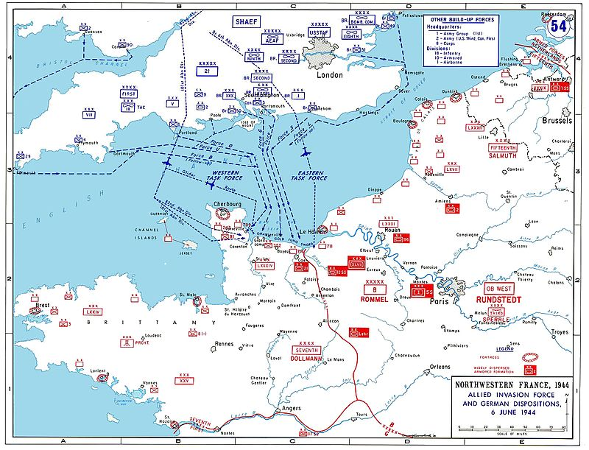
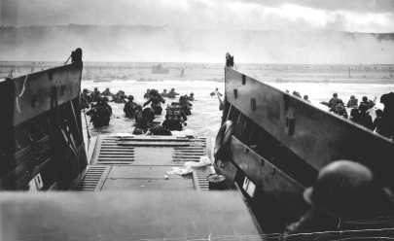
What was Operation Overlord and D-Day?
Warm Up
In 1944 the Allies (British Empire & USA) landed a large army in Normandy in France. Their task was to fight the Nazi German forces that were occupying France and free it from Hitler’s control.
It was the largest amphibious operation in military history. It was also a success. However, it was not easy. Today we will investigate why it was a success.
Knowledge
Check
WATCH
https://www.youtube.com/watch?v=82RTzi5Vt7w&t=134s
Write
Peer
Homework
CHECK
Finished? – Try this…
What defences had the Germans prepared? Did they work?

Slide 4
Why was Operation Overlord a success?
Warm Up
Source pack
Knowledge
1
2
Check
Write
Peer
Read through the source packs in your groups.
List the different reasons why Overlord was a success.
Put your reasons into three or four categories.
Homework
CHECK
Finished? – Try this…
What attributes (characteristics) would you want in a good fighter air craft?

Slide 5
Mini Plenary: Think/Pair/Share
Warm Up
Knowledge
The following four words could each be a category for explaining Operation Overlords success.
What do you think the words mean?
Can you think of any examples from the source packs?
Deception
Logistics.
Bombardment.
Air Superiority.
Don’t forget the Lesson Objective!
We want to be able to examine the factors behind the Allie’s success.
Check
Write
Peer
Homework
Finished? – Try this…
Select one ‘factor’ as being the most responsible for the Allies success
CHECK

Slide 6
Explain why Operation Overlord was a success. (12 marks) You may use the following:
Operation Pluto
Dummy tanks
Warm Up
How do we structure 12 mark questions?
Look back at the feedback you were given for your Causes of the Second World War and Battle of Britain question.
Knowledge
Check
TOP TIP
You must write about three different factors.
They have given you two pieces of evidence.
EVIDENCE IS NOT THE SAME THING AS A FACTOR.
You must decide what the three factors are and then place the evidence in the correct heading.
For example – Russian Revolution is evidence, but ‘Communism’ might be the factor you choose to talk about.
TOP TIP
A short introduction:
List the three factors you will be talking about.
Factor 1 (PEEL)
Factor 2 (PEEL)
Factor 3 (PEEL)
Conclusion:
Explain how the factors link together and which was the most important.
Write
Peer
Homework
CHECK

Slide 7
Explain why Operation Overlord was a success. (12 marks) You may use the following:
Operation Pluto
Dummy tanks
Warm Up
Knowledge
MODEL PARAGRAPH (PEEL):
An additional factor that led to success of Operation Overlord was the use of deception techniques. For example the Allies carefully placed dummy tanks in fields near Dover and they dropped chaff off the coast of Kent before the attack. This was important because together these techniques tricked the Germans into believing the attack was going to happen in Calais, not Normandy. This led the Nazis to send the majority of their army to Calais which meant the Allies had an easier time fighting their way through German defences in Normandy, contributing to their overall success.
Check
Write
Peer
Homework
CHECK
Think: What has the student done well in the example paragraph above?

Slide 8
Explain why Operation Overlord was a success. (12 marks) You may use the following:
Operation Pluto
Dummy tanks
Warm Up
Knowledge
MODEL PARAGRAPH (PEEL):
An additional factor that led to success of Operation Overlord was the use of deception techniques. For example the Allies carefully placed dummy tanks in fields near Dover and they dropped chaff off the coast of Kent before the attack. This was important because together these techniques tricked the Germans into believing the attack was going to happen in Calais, not Normandy. This led the Nazis to send the majority of their army to Calais which meant the Allies had an easier time fighting their way through German defences in Normandy, contributing to their overall success.
Check
Write
Peer
Homework
CHECK
Point
Evidence
Explain
Link to the question

Slide 9
Explain why Operation Overlord was a success. (12 marks) You may use the following:
Operation Pluto
Dummy tanks
Warm Up
Knowledge
TOP TIP
You must write about three different factors.
They have given you two pieces of evidence.
EVIDENCE IS NOT THE SAME THING AS A FACTOR.
You must decide what the three factors are and then place the evidence in the correct heading.
For example – Russian Revolution is evidence, but ‘Communism’ might be the factor you choose to talk about.
TOP TIP
A short introduction:
List the three factors you will be talking about.
Factor 1 (PEEL)
Factor 2 (PEEL)
Factor 3 (PEEL)
Conclusion:
Explain how the factors link together and which was the most important.
Criteria tips:
Each paragraph must clearly link to the question.
Must include detailed facts/figures/dates/names for the period.
Challenge yourself! –Try to use these words in your answer:
Amphibious
Chaff
Superiority
Naval forces
Deception.
Check
Write
Peer
Homework
CHECK

Slide 10
Peer assessment.
Warm Up
Knowledge
PUPIL CRITERIA
Level 1: Some simple points made.
Level 2: There is a structure and some evidence has been used to support points.
Level 3: Paragraphs include some explanation about why the factors made a war more likely/lots of details are used.
Level 4: All paragraphs are clearly and successfully linked to the answer and the conclusion shows how different factors had an impact on each other.
WWW/EBI
starter sentences..
You have included some good detail, for example…
You have explained the factor well, for example you have written…
Your conclusion shows how the different factors linked together, for example you have written…
Check
Write
Peer
Homework
CHECK
Finished? – Try this…
What do you think would have happened to the Nazis if D-Day had failed?

Slide 11
Homework.
Warm Up
Knowledge
FLIP LEARNING SHEET
Check
Write
Peer
Homework
Due for?
CHECK

Slide 12
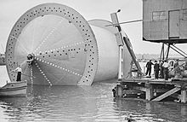
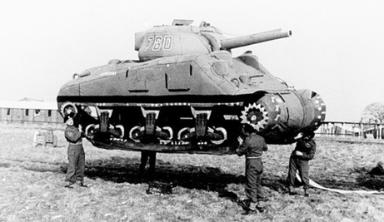
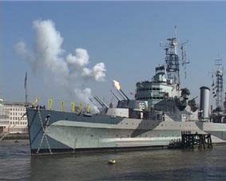
Did we meet our LO?
Warm Up
LO: Examine the factors behind the Allies’ success in the Normandy campaign.
Knowledge
Pick an imagine and ask your partner to explain to you what factor it belongs to and how it helped the Allies be successful.
Check
Write
Peer
Homework
Finished? – Try this…
What do you think would have happened if the D-Day had failed?
CHECK

Slide 13
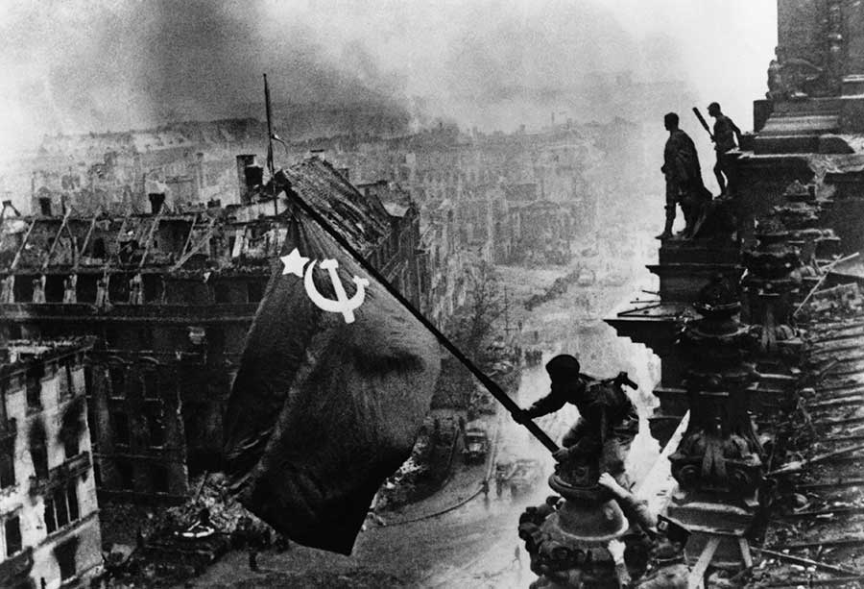
Next Lesson… The fall of Berlin and the end of the Nazis.
Warm Up
Knowledge
Check
Write
Peer
Homework
CHECK

Slide 14
RESOURCES

Slide 15
Source A: An inflatable tank, 1944. For months before the invasion ‘dummy’ tanks and trucks were built and position in field near Dover. The hope was that German aircraft would see them and report back to their commanders, who would then believe the invasion would target Calais in France – not Normandy. By getting the Germans to position their forces near Calais the invasion force would met less resistance when landing in Normandy.

Slide 16
Source B: This is an extract from an RAF pilot’s log during D-Day. He was describing the scene of flying over the assembled ships as they opened fire on the shore.
“The bombing attacks were made through billowing clouds of smoke to the tune of an intense sea to land bombardment by heavy naval guns.”

Slide 17
Source C: An account of an RAF squadron’s activity on June 6th. A Ju188 was a German aircraft. Mosquitoes and Beaufighters were British aircraft. A ‘destroyer’ is a navy ship used to escort larger ships.
During the squadron’s flight they saw a Ju188 shadowing six Allied destroyers. Two 248 Squadron Mosquitoes attacked. Hits were observed on the cockpit and the starboard engine caught fire. The enemy aircraft rolled on its back and spun steeply into the sea shedding pieces of fuselage. None of the Beaufighters or Mosquitoes were damaged.

Slide 18
Source D: Operation Pluto. This was the mission to lay an oil pipeline along the sea bed from Britain to the Normandy beaches. It would allow the Allied militaries to quickly fuel their vehicles and continue fighting. Millions of tonnes of oil would be needed and it would have been too slow and dangerous to transport it all in ships. The pipeline was hugely effective in keeping the Allied armies moving and fighting once they had landed in France.
This photo shows a piece of the pipeline as it was being constructed in Britain.

Slide 19
Source E: HMS Belfast. This was just one of the thousands of Royal Navy and US Navy ship that took part in bombardment operations of the beaches of Normandy before the landings took place. These large ships had powerful guns that could fire explosive shells for miles in land. Today HMS Belfast is a museum on the River Thames in London.

Slide 20
Source F: This is a photograph of a Lancaster bomber dropping ‘Chaff’. Chaff were thousands of small metal strips. If dropped from an aircraft in the sky the cloud of metal appears on radar screens to look like lots of aircraft. On the morning of D-Day lots of British aircraft dropped ‘chaff’ off the coast of Calais to make the Germans believe an air attack was taking place there.

Slide 21
Source H: Taken from an interview with Historian Anthony Beevor. He is explaining why so few German aircraft tried to attack the invasion fleet.
Remember: The Luftwaffe was the name for the German air force. USAF = United States Air Force. RAF= Royal Air Force.
“It was partly because they took the Germans by surprise and also because the Luftwaffe were less effective than they had thought. The RAF and the USAF did an extraordinary job in keeping the Luftwaffe on the ground, with deep patrols right into France.”

Slide 22
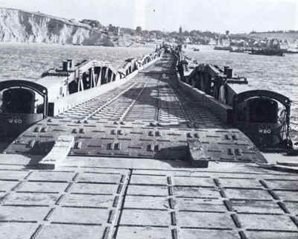
Source H: A photography of the ‘Mulberry Harbour’. This was a floating harbour built in Britain and sailed across to the beaches of Normandy. The Normandy coast line was too shallow for large troop carrying ships to sail up to. So the solution was the Mulberry Harbour. It acted like a long pier that let large ships dock and unload their men and equipment far out to sea. It was a very large piece of engineering and its remains are still visible in France today.

Slide 23
Pre-written feedback slips for printing; Circle the correct grade.
1/2/3
WWW: You have included some basic points/facts about some of the factors.
EBI: Make sure you explain WHY the factors were important.
1/2/3
WWW: You have included some basic points/facts about some of the factors.
EBI: Make sure you explain WHY the factors were important.
1/2/3
WWW: You have included some basic points/facts about some of the factors.
EBI: Make sure you explain WHY the factors were important.
1/2/3
WWW: You have included some basic points/facts about some of the factors.
EBI: Make sure you explain WHY the factors were important.
1/2/3
WWW: You have included some basic points/facts about some of the factors.
EBI: Make sure you explain WHY the factors were important.
1/2/3
WWW: You have included some basic points/facts about some of the factors.
EBI: Make sure you explain WHY the factors were important.
1/2/3
WWW: You have included some basic points/facts about some of the factors.
EBI: Make sure you explain WHY the factors were important.
1/2/3
WWW: You have included some basic points/facts about some of the factors.
EBI: Make sure you explain WHY the factors were important.
1/2/3
WWW: You have included some basic points/facts about some of the factors.
EBI: Make sure you explain WHY the factors were important.
1/2/3
WWW: You have included some basic points/facts about some of the factors.
EBI: Make sure you explain WHY the factors were important.
1/2/3
WWW: You have included some basic points/facts about some of the factors.
EBI: Make sure you explain WHY the factors were important.
1/2/3
WWW: You have included some basic points/facts about some of the factors.
EBI: Make sure you explain WHY the factors were important.

Slide 24
Pre-written feedback slips for printing; Circle the correct grade.
4/5/6
WWW: You have provided an explanation and used some accurate examples.
EBI: Make sure that ALL your paragraphs explain why the factors had a part to play/connect to what the question is asking.
4/5/6
WWW: You have provided an explanation and used some accurate examples.
EBI: Make sure that ALL your paragraphs explain why the factors had a part to play/connect to what the question is asking.
4/5/6
WWW: You have provided an explanation and used some accurate examples.
EBI: Make sure that ALL your paragraphs explain why the factors had a part to play/connect to what the question is asking.
4/5/6
WWW: You have provided an explanation and used some accurate examples.
EBI: Make sure that ALL your paragraphs explain why the factors had a part to play/connect to what the question is asking.
4/5/6
WWW: You have provided an explanation and used some accurate examples.
EBI: Make sure that ALL your paragraphs explain why the factors had a part to play/connect to what the question is asking.
4/5/6
WWW: You have provided an explanation and used some accurate examples.
EBI: Make sure that ALL your paragraphs explain why the factors had a part to play/connect to what the question is asking.
4/5/6
WWW: You have provided an explanation and used some accurate examples.
EBI: Make sure that ALL your paragraphs explain why the factors had a part to play/connect to what the question is asking.
4/5/6
WWW: You have provided an explanation and used some accurate examples.
EBI: Make sure that ALL your paragraphs explain why the factors had a part to play/connect them to what the question is asking.
4/5/6
WWW: You have provided an explanation and used some accurate examples.
EBI: Make sure that ALL your paragraphs explain why the factors had a part to play/connect to what the question is asking.
4/5/6
WWW: You have provided an explanation and used some accurate examples.
EBI: Make sure that ALL your paragraphs explain why the factors had a part to play/connect them to what the question is asking.
4/5/6
WWW: You have provided an explanation and used some accurate examples.
EBI: Make sure that ALL your paragraphs explain why the factors had a part to play/connect to what the question is asking.
4/5/6
WWW: You have provided an explanation and used some accurate examples.
EBI: Make sure that ALL your paragraphs explain why the factors had a part to play/connect them to what the question is asking.

Slide 25
Pre-written feedback slips for printing; Circle the correct grade.
7/8/9
WWW: You have explained your answer well throughout the question and used detailed facts to support your points.
EBI: Add a conclusion that shows clearly how the different factors are linked and impact each other, try also to explain which was the most influential.
7/8/9
WWW: You have explained your answer well throughout the question and used detailed facts to support your points.
EBI: Add a conclusion that shows clearly how the different factors are linked and impact each other, try also to explain which was the most influential.
7/8/9
WWW: You have explained your answer well throughout the question and used detailed facts to support your points.
EBI: Add a conclusion that shows clearly how the different factors are linked and impact each other, try also to explain which was the most influential.
7/8/9
WWW: You have explained your answer well throughout the question and used detailed facts to support your points.
EBI: Add a conclusion that shows clearly how the different factors are linked and impact each other, try also to explain which was the most influential.
7/8/9
WWW: You have explained your answer well throughout the question and used detailed facts to support your points.
EBI: Add a conclusion that shows clearly how the different factors are linked and impact each other, try also to explain which was the most influential.
7/8/9
WWW: You have explained your answer well throughout the question and used detailed facts to support your points.
EBI: Add a conclusion that shows clearly how the different factors are linked and impact each other, try also to explain which was the most influential.
7/8/9
WWW: You have explained your answer well throughout the question and used detailed facts to support your points.
EBI: Add a conclusion that shows clearly how the different factors are linked and impact each other, try also to explain which was the most influential.
7/8/9
WWW: You have explained your answer well throughout the question and used detailed facts to support your points.
EBI: Add a conclusion that shows clearly how the different factors are linked and impact each other, try also to explain which was the most influential.
7/8/9
WWW: You have explained your answer well throughout the question and used detailed facts to support your points.
EBI: Add a conclusion that shows clearly how the different factors are linked and impact each other, try also to explain which was the most influential.
7/8/9
WWW: You have explained your answer well throughout the question and used detailed facts to support your points.
EBI: Add a conclusion that shows clearly how the different factors are linked and impact each other, try also to explain which was the most influential.
7/8/9
WWW: You have explained your answer well throughout the question and used detailed facts to support your points.
EBI: Add a conclusion that shows clearly how the different factors are linked and impact each other, try also to explain which was the most influential.
7/8/9
WWW: You have explained your answer well throughout the question and used detailed facts to support your points.
EBI: Add a conclusion that shows clearly how the different factors are linked and impact each other, try also to explain which was the most influential.

Slide 26
Pre-written feedback slips for printing; Circle the correct grade.
10/11/12
WWW: You have shown a good line of reasoning throughout your work which leads nicely to a logical and well thought out conclusion.
EBI: In your conclusion you could categorise the factors into long term or short term – and explain why.
10/11/12
WWW: You have shown a good line of reasoning throughout your work which leads nicely to a logical and well thought out conclusion.
EBI: In your conclusion you could categorise the factors into long term or short term – and explain why.
10/11/12
WWW: You have shown a good line of reasoning throughout your work which leads nicely to a logical and well thought out conclusion.
EBI: In your conclusion you could categorise the factors into long term or short term – and explain why.
10/11/12
WWW: You have shown a good line of reasoning throughout your work which leads nicely to a logical and well thought out conclusion.
EBI: In your conclusion you could categorise the factors into long term or short term – and explain why.
10/11/12
WWW: You have shown a good line of reasoning throughout your work which leads nicely to a logical and well thought out conclusion.
EBI: In your conclusion you could categorise the factors into long term or short term – and explain why.
10/11/12
WWW: You have shown a good line of reasoning throughout your work which leads nicely to a logical and well thought out conclusion.
EBI: In your conclusion you could categorise the factors into long term or short term – and explain why.
10/11/12
WWW: You have shown a good line of reasoning throughout your work which leads nicely to a logical and well thought out conclusion.
EBI: In your conclusion you could categorise the factors into long term or short term – and explain why.
10/11/12
WWW: You have shown a good line of reasoning throughout your work which leads nicely to a logical and well thought out conclusion.
EBI: In your conclusion you could categorise the factors into long term or short term – and explain why.
10/11/12
WWW: You have shown a good line of reasoning throughout your work which leads nicely to a logical and well thought out conclusion.
EBI: In your conclusion you could categorise the factors into long term or short term – and explain why.
10/11/12
WWW: You have shown a good line of reasoning throughout your work which leads nicely to a logical and well thought out conclusion.
EBI: In your conclusion you could categorise the factors into long term or short term – and explain why.
10/11/12
WWW: You have shown a good line of reasoning throughout your work which leads nicely to a logical and well thought out conclusion.
EBI: In your conclusion you could categorise the factors into long term or short term – and explain why.
10/11/12
WWW: You have shown a good line of reasoning throughout your work which leads nicely to a logical and well thought out conclusion.
EBI: In your conclusion you could categorise the factors into long term or short term – and explain why.

Slide 27
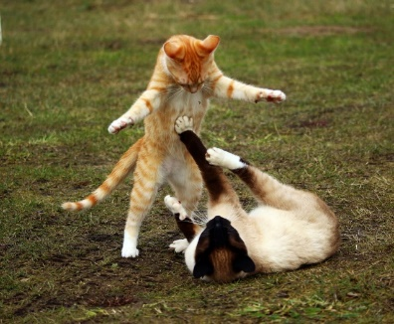
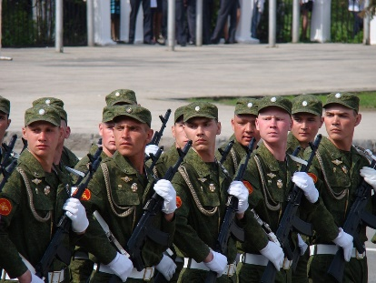
EAL ASSISSTANCE SHEET
Countries:
Europe
Germany
Russia (Soviet Union)
France
Britain
Normandy (part of France)
Key verbs:
To fight
To supply
To trick
Key nouns:
Beach
Troops
Casualty
Can you match the noun to the correct image?
Can you match the verb to the correct image?
Can you find them on the map?

Slide 28
SUPPORT TEMPLATE FOR 12 MARK QUESTIONS.
Use words from the question to help get you started.
List the main factors you will discuss, e.g. “There are three main factors that contributed to Britain’s success, they are aircraft, technology and strategy.”
Structure
Plan your answer, you will need:
THREE FACTORS (not just three pieces of evidence)
Introductions
Explain why the RAF won the Battle of Britain.
You may use the following.
Spitfire
Radar
You will also need to include knowledge of your own.
Simple paragraph sentence starters:
Point: One/Another important factor was…
Evidence: For example…
Explain: This was important because…
Link: This contributed to (the question focus) because…
Paragraphs
Introduction
Factor 1: Aircraft.
Evidence? Spitfire
Factor 2: Technology
Evidence? Radar
Factor 3: From own knowledge.
Evidence: From own knowledge.
Conclusion.
Conclusions
DO | DO NOT
Directly answer the Q Explain why one factor was the most important. Compare the factors – show how they overlap and impact each other. | Just ‘state’ that one factor is the most important. Only summarise your argument, Introduce new evidence (do that in your main paragraphs).
For example, here ‘radar’ is the evidence used to support ‘technology’ as a wider factor.

Slide 29
Lesson plan
Teacher: Date: Lesson: Subject: Class:
Contextual information about the group and their previous learning:
Half way through the WW2 SOW.
Focus of learning/What will progress look like?
Students will answer a twelve mark exam question. In so doing they will demonstrate the new knowledge learnt during the source pack activityThey will also incorporate exam technique guidance from the ppt and advice sheet.
What will be assessed? How? When will the students act on this?
Source pack activity will assess their ability to categorise.
Mini plenary/check: Class discussion of answers will address any short comings in understanding. Main activity: Students ability to prioritise complex reasons and justify their decisions.
Additional support and challenge: (PP/More Able/SEND/EAL)
Challenge questions throughout the lesson. Literacy challenge during main task for more able. EAL support sheet for applicable students. 12 mark support template for SEND.
Where can I support QWC/Numeracy?
Reading comprehension/ literacy SPAG/numeracy settler activity.
Lesson narrative:
Literacy/Numeracy settler activity → Source pack activty → 12 mark exam question practice → Prioritise and justify plenary.
Homework:

Slide 30
FLIP LEARNING HOMEWORK SHEET
www.wolseyacademy.co.uk
Check out our Virtual Learning Worlds! (coming soon)
Pupils can roam the fields of history, talk to historical characters and investigate the factors behind key events as if they were really there!
Each comes with its own ‘flip learning’ homework sheet so pupils enter the class inspired, intrigued and ready to learn.

Slide 31
WHY BOTHER? PEDAGOGY JUSTIFICATION
Activity | Justification/Evidence?
Clear Lesson Objective and revisited during plenary. | Professor John Hattie’s “visible learning” looks at meta studies of educational approaches. He concludes that having a clear learning objective, that is revisited throughout the lesson, is a more effective method of achieving high outcomes than merely insisting on high expectations ‘in general’ from the class. Visible Learning. John Hattie, 2008.
Mini plenary: Think/Pair/Share – provides thinking time to students. | Kathleen Cotton’s paper Classroom Questioning concludes that “training teachers in increased wait time is positively related to student achievement”. Think/Pair/Share is an effective means of embedding this practice into your lessons. http://www.learner.org/workshops/socialstudies/pdf/session6/6.ClassroomQuestioning.pdf
Source analysis and categorisation. | Research by Bruner shows that categorisation skills is a key building block in higher level thought. By identifying similar features and using categories it eliminates the need for constant learning thereby providing an economy in mental effort and an efficiency in learning. https://books.google.co.uk/books/about/A_Study_of_Thinking.html?id=xDZlQgt-xa0C
Pre-made feedback slips. | Professor John Hattie has identified frequent feedback as the “most powerful single moderator that enhances achievement”. (taken from https://cdn.auckland.ac.nz/assets/education/hattie/docs/influences-on-student-learning.pdf. Feedback should be tailored to the individual student’s needs. However, as we all know, teaching is an excessively labour intensive process and finding the time to provide accurate bespoke feedback on all occasions can be difficult. Additionally the speed of feedback is an important factor in its effectiveness. Quick ‘off the shelf’ feedback like this can help form positive feed-back loops for students when teachers would otherwise not have the time to do so. (see: https://www.wired.com/2011/06/ff_feedbackloop/) To this end the ready made feedback slips are intended to form the basis of more detailed feedback – or to play an important if imperfect role in providing quick feedback. The speed
Group question/answer plenary. | Group projects can help students develop a host of skills that are increasingly important in the professional world (Caruso & Woolley, 2008; Mannix & Neale, 2005). Positive group experiences, moreover, have been shown to contribute to student learning, retention and overall college success (Astin, 1997; Tinto, 1998; National Survey of Student Engagement, 2006).
Introducing the 12 mark question in the first lesson or the SOW and revisiting it after a break of several lessons. | A meta-analysis of studies on the impact of repeated practice has found that ‘individuals in spaced practice conditions performed significantly higher than those in massed practice conditions”. This is this SOW tries to equally space practice of the same style of exam questions. The study does however also indicate that the style of the practice makes a huge difference to the impact and that further research was probably required to make a conclusive judgement on how style and repetition of activity interacted. http://psycnet.apa.org/psycinfo/1999-01454-012 Study by John Donovan and John Radosevich.

Slide 32
At a glance… Second World War SOW
Number | 1 | 2 | 3 | 4 | 5 | 6 | 7 | 8 | 9
Title | Causes | Phoney War & Norway | Battle of the Atlantic & Engima | Blitzkreig & Maginot Line | Dunkirk, Vichy & Mers-el-Kebir. | Battle of Britain & Radar | Africa & SAS | Barbarossa | Tehran Conference
Exam Q style or activity style. | 12 mark essay Q (based on Edexcel) |  |  |  |  | 12 mark essay Q (based on Edexcel)
All available at the Wolsey Academy
TES Shop

Slide 33
At a glance… Second World War SOW
Number | 10 | 11 | 12 | 13 | 14 | 15 | 16 | 17 | 18
Title | Italy | D-Day | Berlin | China and Japan | Pearl Harbour | Battle of Midway | Atom Bombs | Holocaust | Iron Curtain
Exam Q style or activity style. |  | 12 mark essay Q (based on Edexcel)
All available at the Wolsey Academy
TES Shop

Slide 34
www.wolseyacademy.co.uk

