Slide 1
Quick Start Guide:
Pupils lining up at the door? Not had your coffee yet?
Follow our quick start guide…
1
Print and copy 10 sets of the three info pages (slides 16-18)
(Optional)
Print and copy:
12 mark guidance sheet (slide 24)
EAL assistance sheet (slide 23)
2
Think about how you will split the class into thirds – and then groups of three.
3
Put up title slide, meet students at door and instruct them to begin the Literacy/Numeracy settler task.

Slide 2
The long term causes of the Second World War, 1917-1939
Warm Up
LO: Explain the relative importance of the factors that contributed to the outbreak of war in Europe.
Appeasement: A series of decisions made in the run up to the Second World War in which the Allies gave in to Hitler’s demands hoping to avoid war (add to glossary in back of book (BOB)).
Knowledge
Check
“I want to say that the progress we have made in peace, which has now been achieved is, in my view, only the prelude to a larger settlement in which all Europe may find peace.”
Prime Minister Neville Chamberlain, 1938.
Q: What can you learn from this statement about Chamberlain?
SPAG?
Correct the mistakes.
The Prime ministers policy of appeasement towards germany in the 1930s is often criticised by historians. However at the time many british people were terrorfied at the thought of another conflict in europe.
Numeracy:
The Russian Revolution occurred in 1917 and turned Russia Communist. How many years had Russia been Communist before the outbreak of the Second World War?
Write
Peer
Homework
CHECK
Finished? – Try this..
Why do countries go to war? List as many possible reasons as you can think of.
Notes:
Answer: 22
NOTE: The first time you try this ‘lit/spag/num’ settler grid it may take the pupils a little while to complete. However as the SOW progresses and this activity becomes embedded they do get quicker.

Slide 3
Become the expert!
Warm Up
Step 1: Draw or stick the table in your books.
The Soviet Union and Communism | Hitler and Lebensraum | Appeasement
Knowledge
Check
Step 2: You will be split into three groups.
Step 3: Each group will receive one of the three information sheets.
Write
Peer
Step 4: Read the sheet and write down the 5Ws in the relevant part of the table.
Homework
CHECK
Finished? – Try this…
Think back to previous lessons - How do you think the Treaty of Versailles contributed to the onset of the Second World War?

Slide 4
Teach the group!
Warm Up
Step 5: Get into groups of three. With one ‘expert’ in each area in the group.
Step 6: Take it in turns to explain to the group the key points about your area of expertise.
Knowledge
Check
Write
Step 7: Everyone to complete the table.
Peer
Homework
CHECK
Finished? – Try this…
Think back to previous lessons - How do you think the Treaty of Versailles contributed to the onset of the Second World War?

Slide 5
Mini Plenary: Does everyone in your group know the answers to these questions? Let’s find out…
Warm Up
Knowledge
Describe what the word Lebensraum means.
Explain why other countries were afraid of the Soviet Union.
Explain why appeasement may have made war more likely.
Don’t forget the Lesson Objective!
We want to be able to explain the relative important of the factors that led to war in Europe!
Check
Write
Peer
Homework
Finished? – Try this…
Select one ‘factor’ as being the most responsible for starting the Second World War and explain why.
CHECK

Slide 6
Explain why a world war became likely in the 1930s.
(12 marks) You may use the following:
Russian Revolution 1917
Munich Agreement 1938.
Warm Up
How do we structure 12 mark questions?
Knowledge
Check
TOP TIP
You must write about three different factors.
They have given you two pieces of evidence.
EVIDENCE IS NOT THE SAME THING AS A FACTOR.
You must decide what the three factors are and then place the evidence in the correct heading.
For example – Russian Revolution is evidence, but ‘Communism’ might be the factor you choose to talk about.
TOP TIP
A short introduction:
List the three factors you will be talking about.
Factor 1 (PEEL)
Factor 2 (PEEL)
Factor 3 (PEEL)
Conclusion:
Explain how the factors link together and which was the most important.
Write
Peer
Homework
CHECK

Slide 7
Explain why a second world war became likely in the 1930s. (12 marks) You may use the following:
Russian Revolution 1917
Munich Agreement 1938.
Warm Up
Knowledge
MODEL PARAGRAPH (PEEL):
One factor that made the outbreak of a second world war more likely was the rise of the Soviet Union. Since the Russian Revolution in 1917 the Soviets had tried to spread communism to other countries by encouraging workers to rise up against the leaders. Germany felt especially threatened by this behaviour as it had to fight off its own communist revolution in 1920. This contributed to making war more likely because if forced countries like Germany to feel they needed a large army to defend themselves from any attack.
Check
Write
Peer
Homework
CHECK
Think: What has the student done well in the example paragraph above?

Slide 8
Explain why a second world war became likely in the 1930s. (12 marks) You may use the following:
Russian Revolution 1917
Munich Agreement 1938.
Warm Up
Knowledge
MODEL PARAGRAPH (PEEL):
One factor that made the outbreak of a second world war more likely was the rise of the Soviet Union. Since the Russian Revolution in 1917 the Soviets had tried to spread communism to other countries by encouraging workers to rise up against the leaders. Germany felt especially threatened by this behaviour as it had to fight off its own communist revolution in 1920. This contributed to making war more likely because if forced countries like Germany to feel they needed a large army to defend themselves from any attack.
Check
Write
Peer
Homework
CHECK
Point
Evidence
Explain
Link to the question

Slide 9
Explain why a world war became likely in the 1930s. (12 marks) You may use the following:
Russian Revolution 1917
Munich Agreement 1938.
Warm Up
Knowledge
TOP TIP
You must write about three different factors.
They have given you two pieces of evidence.
EVIDENCE IS NOT THE SAME THING AS A FACTOR.
You must decide what the three factors are and then place the evidence in the correct heading.
For example – Russian Revolution is evidence, but ‘Communism’ might be the factor you choose to talk about.
TOP TIP
A short introduction:
List the three factors you will be talking about.
Factor 1 (PEEL)
Factor 2 (PEEL)
Factor 3 (PEEL)
Conclusion:
Explain how the factors link together and which was the most important.
Criteria tips:
Each paragraph must clearly link to the question.
Must include detailed facts/figures/dates/names for the period.
Challenge yourself! –Try to use these words in your answer:
Consequence
Repercussions
Contributed
Tensions
Check
Write
Peer
Homework
CHECK

Slide 10
Peer assessment.
Warm Up
Knowledge
PUPIL CRITERIA
Level 1: Some simple points made.
Level 2: There is a structure and some evidence has been used to support points.
Level 3: Paragraphs include some explanation about why the factors made a war more likely/lots of details are used.
Level 4: All paragraphs are clearly and successfully linked to the answer and the conclusion shows how different factors had an impact on each other.
WWW/EBI
starter sentences..
You have included some good detail, for example…
You have explained the factor well, for example you have written…
Your conclusion shows how the different factors linked together, for example you have written…
Check
Write
Peer
Homework
CHECK
Finished? – Try this…
Who was most to blame for the Second World War starting? Why?

Slide 11
Homework.
Warm Up
Knowledge
FLIP LEARNING SHEET
Check
Write
Peer
Homework
Due for?
CHECK

Slide 12
Did we meet our LO?
Warm Up
LO: Explain the relative importance of the factors that contributed to the outbreak of war in Europe.
Knowledge
Sort the three factors into order of importance.
Write them on your whiteboards…
Be ready to justify your decisions…
Class discussions.
Check
Write
Peer
Homework
Finished? – Try this…
Why would communism have been an attractive idea to some workers in Europe during the 1930s?
CHECK

Slide 13
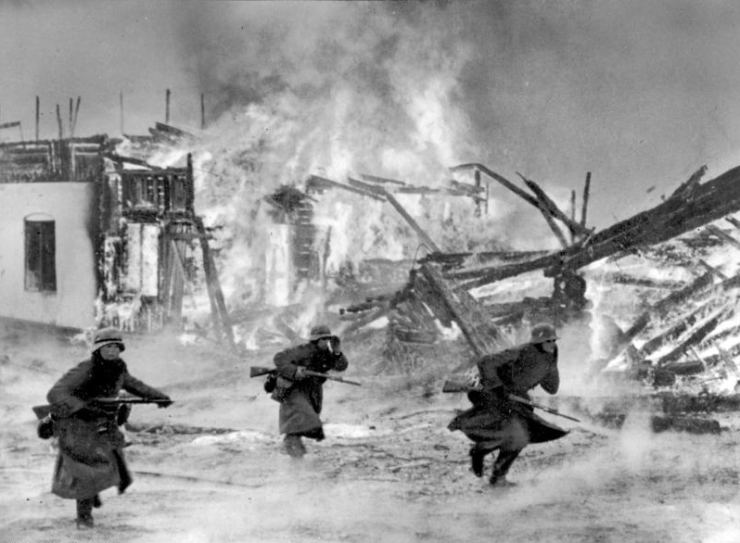
Next Lesson… Phoney War and Norway Campaign, 1940
Warm Up
Knowledge
Check
Write
Peer
Homework
CHECK

Slide 14
RESOURCES

Slide 15
LO: Explain the relative importance of the factors that contributed to the outbreak of war in Europe.
The Soviet Union and Communism | Hitler and Lebensraum | Appeasement

Slide 16
The Soviet Union and Communism
In 1917 Russia had a revolution which turned the country communist. Communists believed the workers should run the country, not the rich managers and business owners. Their leader was called Vladimir Lenin but he was soon replaced with Joseph Stalin. Stalin was a ruthless leader.
Russia came to lead a collection of 15 smaller communist countries that together was called the Soviet Union. The Soviet Union tried to encourage workers in other countries to attack their leaders and replace them with Communists. They wanted to see a world wide revolution. This frightened many other countries who were worried about a revolution occurring in their own country.
The fear of communism was especially strong in Germany. In 1920 a communist revolution was stopped after much fighting. The Nazis promised to stop communism. This caused a lot of tension between Nazi Germany and the Soviet Union. Hitler made lots of speeches saying how the Soviet Union needed to be destroyed.

Slide 17
Hitler and Lebensraum
Hitler’s Nazi Party believed that Germany needed more land for its people to live in. They called this idea Lebensraum which means ‘living space’ in English. They saw the lands in Eastern Europe and Russia as areas they wanted. Hitler’s dream was to see the people in these areas, who he referred to as the slavs, removed and replaced with German farmers and their families.
When Hitler came to power in 1933 he began to plan to take over these lands.
He believed this would give Germany access to the land and resources it needed to be the strong powerful country he wanted it to become. Hitler did not make his plans secret, the Nazi Party often published these ideas in newspapers and books.
The Russians were obviously very concerned by these ideas and both sides began to prepare for war.

Slide 18
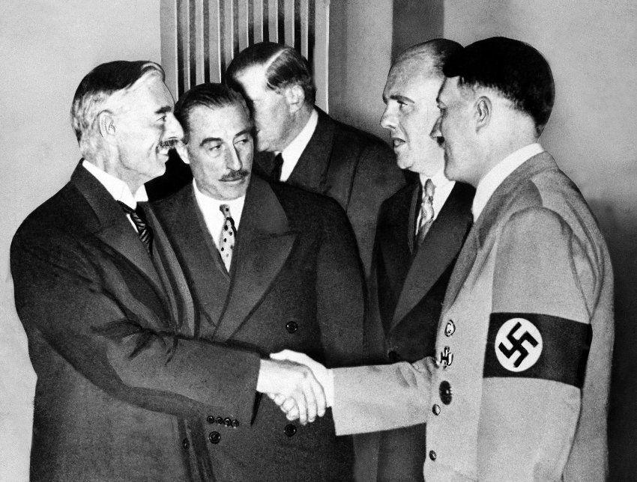
Appeasement
The Western European countries were very concerned about the thought of a new war in Europe. The leaders of Britain and France remembered the horrors of the First World War and did not want to see it happen again.
When Hitler began to break the rules laid down in the Treaty of Versailles they did not try to stop him. Instead they ‘appeased’ Hitler’s demands because they did not want to start a war. Hitler rebuilt the German army and navy. He also merged Germany with Austria and took over an area of Czechoslovakia called the Sudetenland.
This last moved was agreed between Hitler and Neville Chamberlain, the British Prime Minister, at a meeting in Munich in 1938. Chamberlain said there would be ‘peace in our time’ and that Hitler had promised him he would not try to invade anyone else ever again.
The agreement did not last very long. Hitler invaded Poland in September 1939 and Chamberlain was forced to admit he had failed to convince Hitler to stop his aggressive actions. Britain declared war on Germany on September 3rd, 1939. This is the date usually seen as the ‘start’ of the Second World War.
This picture shows Neville Chamberlain shaking Hitler’s hand after the Munich Conference. The two men had agreed Germany could take over the Sudetenland but then Germany had to stop growing larger.

Slide 19
Pre-written feedback slips for printing; Circle the correct grade.
1/2/3
WWW: You have included some basic points/facts about some of the factors.
EBI: Make sure you explain WHY the factors were important.
1/2/3
WWW: You have included some basic points/facts about some of the factors.
EBI: Make sure you explain WHY the factors were important.
1/2/3
WWW: You have included some basic points/facts about some of the factors.
EBI: Make sure you explain WHY the factors were important.
1/2/3
WWW: You have included some basic points/facts about some of the factors.
EBI: Make sure you explain WHY the factors were important.
1/2/3
WWW: You have included some basic points/facts about some of the factors.
EBI: Make sure you explain WHY the factors were important.
1/2/3
WWW: You have included some basic points/facts about some of the factors.
EBI: Make sure you explain WHY the factors were important.
1/2/3
WWW: You have included some basic points/facts about some of the factors.
EBI: Make sure you explain WHY the factors were important.
1/2/3
WWW: You have included some basic points/facts about some of the factors.
EBI: Make sure you explain WHY the factors were important.
1/2/3
WWW: You have included some basic points/facts about some of the factors.
EBI: Make sure you explain WHY the factors were important.
1/2/3
WWW: You have included some basic points/facts about some of the factors.
EBI: Make sure you explain WHY the factors were important.
1/2/3
WWW: You have included some basic points/facts about some of the factors.
EBI: Make sure you explain WHY the factors were important.
1/2/3
WWW: You have included some basic points/facts about some of the factors.
EBI: Make sure you explain WHY the factors were important.

Slide 20
Pre-written feedback slips for printing; Circle the correct grade.
4/5/6
WWW: You have provided an explanation and used some accurate examples.
EBI: Make sure that ALL your paragraphs explain why the factors had a part to play/connect to what the question is asking.
4/5/6
WWW: You have provided an explanation and used some accurate examples.
EBI: Make sure that ALL your paragraphs explain why the factors had a part to play/connect to what the question is asking.
4/5/6
WWW: You have provided an explanation and used some accurate examples.
EBI: Make sure that ALL your paragraphs explain why the factors had a part to play/connect to what the question is asking.
4/5/6
WWW: You have provided an explanation and used some accurate examples.
EBI: Make sure that ALL your paragraphs explain why the factors had a part to play/connect to what the question is asking.
4/5/6
WWW: You have provided an explanation and used some accurate examples.
EBI: Make sure that ALL your paragraphs explain why the factors had a part to play/connect to what the question is asking.
4/5/6
WWW: You have provided an explanation and used some accurate examples.
EBI: Make sure that ALL your paragraphs explain why the factors had a part to play/connect to what the question is asking.
4/5/6
WWW: You have provided an explanation and used some accurate examples.
EBI: Make sure that ALL your paragraphs explain why the factors had a part to play/connect to what the question is asking.
4/5/6
WWW: You have provided an explanation and used some accurate examples.
EBI: Make sure that ALL your paragraphs explain why the factors had a part to play/connect them to what the question is asking.
4/5/6
WWW: You have provided an explanation and used some accurate examples.
EBI: Make sure that ALL your paragraphs explain why the factors had a part to play/connect to what the question is asking.
4/5/6
WWW: You have provided an explanation and used some accurate examples.
EBI: Make sure that ALL your paragraphs explain why the factors had a part to play/connect them to what the question is asking.
4/5/6
WWW: You have provided an explanation and used some accurate examples.
EBI: Make sure that ALL your paragraphs explain why the factors had a part to play/connect to what the question is asking.
4/5/6
WWW: You have provided an explanation and used some accurate examples.
EBI: Make sure that ALL your paragraphs explain why the factors had a part to play/connect them to what the question is asking.

Slide 21
Pre-written feedback slips for printing; Circle the correct grade.
7/8/9
WWW: You have explained your answer well throughout the question and used detailed facts to support your points.
EBI: Add a conclusion that shows clearly how the different factors are linked and impact each other, try also to explain which was the most influential.
7/8/9
WWW: You have explained your answer well throughout the question and used detailed facts to support your points.
EBI: Add a conclusion that shows clearly how the different factors are linked and impact each other, try also to explain which was the most influential.
7/8/9
WWW: You have explained your answer well throughout the question and used detailed facts to support your points.
EBI: Add a conclusion that shows clearly how the different factors are linked and impact each other, try also to explain which was the most influential.
7/8/9
WWW: You have explained your answer well throughout the question and used detailed facts to support your points.
EBI: Add a conclusion that shows clearly how the different factors are linked and impact each other, try also to explain which was the most influential.
7/8/9
WWW: You have explained your answer well throughout the question and used detailed facts to support your points.
EBI: Add a conclusion that shows clearly how the different factors are linked and impact each other, try also to explain which was the most influential.
7/8/9
WWW: You have explained your answer well throughout the question and used detailed facts to support your points.
EBI: Add a conclusion that shows clearly how the different factors are linked and impact each other, try also to explain which was the most influential.
7/8/9
WWW: You have explained your answer well throughout the question and used detailed facts to support your points.
EBI: Add a conclusion that shows clearly how the different factors are linked and impact each other, try also to explain which was the most influential.
7/8/9
WWW: You have explained your answer well throughout the question and used detailed facts to support your points.
EBI: Add a conclusion that shows clearly how the different factors are linked and impact each other, try also to explain which was the most influential.
7/8/9
WWW: You have explained your answer well throughout the question and used detailed facts to support your points.
EBI: Add a conclusion that shows clearly how the different factors are linked and impact each other, try also to explain which was the most influential.
7/8/9
WWW: You have explained your answer well throughout the question and used detailed facts to support your points.
EBI: Add a conclusion that shows clearly how the different factors are linked and impact each other, try also to explain which was the most influential.
7/8/9
WWW: You have explained your answer well throughout the question and used detailed facts to support your points.
EBI: Add a conclusion that shows clearly how the different factors are linked and impact each other, try also to explain which was the most influential.
7/8/9
WWW: You have explained your answer well throughout the question and used detailed facts to support your points.
EBI: Add a conclusion that shows clearly how the different factors are linked and impact each other, try also to explain which was the most influential.

Slide 22
Pre-written feedback slips for printing; Circle the correct grade.
10/11/12
WWW: You have shown a good line of reasoning throughout your work which leads nicely to a logical and well thought out conclusion.
EBI: In your conclusion you could categorise the factors into long term or short term – and explain why.
10/11/12
WWW: You have shown a good line of reasoning throughout your work which leads nicely to a logical and well thought out conclusion.
EBI: In your conclusion you could categorise the factors into long term or short term – and explain why.
10/11/12
WWW: You have shown a good line of reasoning throughout your work which leads nicely to a logical and well thought out conclusion.
EBI: In your conclusion you could categorise the factors into long term or short term – and explain why.
10/11/12
WWW: You have shown a good line of reasoning throughout your work which leads nicely to a logical and well thought out conclusion.
EBI: In your conclusion you could categorise the factors into long term or short term – and explain why.
10/11/12
WWW: You have shown a good line of reasoning throughout your work which leads nicely to a logical and well thought out conclusion.
EBI: In your conclusion you could categorise the factors into long term or short term – and explain why.
10/11/12
WWW: You have shown a good line of reasoning throughout your work which leads nicely to a logical and well thought out conclusion.
EBI: In your conclusion you could categorise the factors into long term or short term – and explain why.
10/11/12
WWW: You have shown a good line of reasoning throughout your work which leads nicely to a logical and well thought out conclusion.
EBI: In your conclusion you could categorise the factors into long term or short term – and explain why.
10/11/12
WWW: You have shown a good line of reasoning throughout your work which leads nicely to a logical and well thought out conclusion.
EBI: In your conclusion you could categorise the factors into long term or short term – and explain why.
10/11/12
WWW: You have shown a good line of reasoning throughout your work which leads nicely to a logical and well thought out conclusion.
EBI: In your conclusion you could categorise the factors into long term or short term – and explain why.
10/11/12
WWW: You have shown a good line of reasoning throughout your work which leads nicely to a logical and well thought out conclusion.
EBI: In your conclusion you could categorise the factors into long term or short term – and explain why.
10/11/12
WWW: You have shown a good line of reasoning throughout your work which leads nicely to a logical and well thought out conclusion.
EBI: In your conclusion you could categorise the factors into long term or short term – and explain why.
10/11/12
WWW: You have shown a good line of reasoning throughout your work which leads nicely to a logical and well thought out conclusion.
EBI: In your conclusion you could categorise the factors into long term or short term – and explain why.

Slide 23
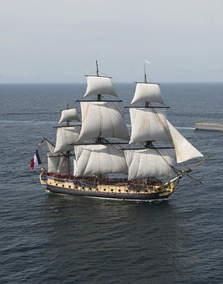
EAL ASSISSTANCE SHEET
Countries:
Europe
Germany
Russia (Soviet Union)
Czechoslovakia
France
Britain
Key verbs:
(to revolt) Revolution
To give a speech.
To farm
To remember
Key nouns:
Peace
Army
Navy
Worker
Family
Can you match the noun to the correct image?
Can you find them on the map?
Can you match the verb to the correct image?

Slide 24
SUPPORT TEMPLATE FOR 12 MARK QUESTIONS.
Use words from the question to help get you started.
List the main factors you will discuss, e.g. “There are three main factors that contributed to Britain’s success, they are aircraft, technology and strategy.”
Structure
Plan your answer, you will need:
THREE FACTORS (not just three pieces of evidence)
Introductions
Explain why the RAF won the Battle of Britain.
You may use the following.
Spitfire
Radar
You will also need to include knowledge of your own.
Simple paragraph sentence starters:
Point: One/Another important factor was…
Evidence: For example…
Explain: This was important because…
Link: This contributed to (the question focus) because…
Paragraphs
Introduction
Factor 1: Aircraft.
Evidence? Spitfire
Factor 2: Technology
Evidence? Radar
Factor 3: From own knowledge.
Evidence: From own knowledge.
Conclusion.
Conclusions
DO | DO NOT
Directly answer the Q Explain why one factor was the most important. Compare the factors – show how they overlap and impact each other. | Just ‘state’ that one factor is the most important. Only summarise your argument, Introduce new evidence (do that in your main paragraphs).
For example, here ‘radar’ is the evidence used to support ‘technology’ as a wider factor.

Slide 25
Lesson plan
Teacher: Date: Lesson: Subject: Class:
Contextual information about the group and their previous learning:
First lesson on the Second World War. Class has previously studied the consequences of the First World War, Treaty of Versailles and the rise of Nazi Germany.
Focus of learning/What will progress look like?
Students will answer a twelve mark exam question. In so doing they will demonstrate the new knowledge learnt during the teach the expert activity. They will also incorporate exam technique guidance from the ppt and advice sheet.
What will be assessed? How? When will the students act on this?
Expert teach activity assess pupil’s ability to work with others,.
Mini plenary/check: Class discussion of answers will address any short comings in understanding. Main activity: Students ability to prioritise complex reasons and justify their decisions.
Additional support and challenge: (PP/More Able/SEND/EAL)
Challenge questions throughout the lesson. Literacy challenge during main task for more able. EAL support sheet for applicable students. 12 mark support template for SEND.
Where can I support QWC/Numeracy?
Reading comprehension/ literacy SPAG/numeracy settler activity.
Lesson narrative:
Literacy/Numeracy settler activity → Expert teacher group activity → 12 mark exam question practice → Prioritise and justify plenary.
Homework:

Slide 26
FLIP LEARNING HOMEWORK SHEET
www.wolseyacademy.co.uk
Check out our Virtual Learning Worlds! (coming soon)
Pupils can roam the fields of history, talk to historical characters and investigate the factors behind key events as if they were really there!
Each comes with its own ‘flip learning’ homework sheet so pupils enter the class inspired, intrigued and ready to learn.

Slide 27
WHY BOTHER? PEDAGOGY JUSTIFICATION
Activity | Justification/Evidence?
Clear Lesson Objective and revisited during plenary. | Professor John Hattie’s “visible learning” looks at meta studies of educational approaches. He concludes that having a clear learning objective, that is revisited throughout the lesson, is a more effective method of achieving high outcomes than merely insisting on high expectations ‘in general’ from the class. Visible Learning. John Hattie, 2008.
Mini plenary: Think/Pair/Share – provides thinking time to students. | Kathleen Cotton’s paper Classroom Questioning concludes that “training teachers in increased wait time is positively related to student achievement”. Think/Pair/Share is an effective means of embedding this practice into your lessons. http://www.learner.org/workshops/socialstudies/pdf/session6/6.ClassroomQuestioning.pdf
Expert teacher group work. | Group work is great for building interpersonal skills. However as every teacher knows the phoneme of ‘social loafing’ where a student will work less hard in a group than they would do individually – is all to real. Therefore the ‘expert teacher’ approach tries to counter this tendency by giving each student a predefined role – e.g. becoming an expert in an area the others are not and being responsible for sharing that work.
Pre-made feedback slips. | Professor John Hattie has identified frequent feedback as the “most powerful single moderator that enhances achievement”. (taken from https://cdn.auckland.ac.nz/assets/education/hattie/docs/influences-on-student-learning.pdf. Feedback should be tailored to the individual student’s needs. However, as we all know, teaching is an excessively labour intensive process and finding the time to provide accurate bespoke feedback on all occasions can be difficult. Additionally the speed of feedback is an important factor in its effectiveness. Quick ‘off the shelf’ feedback like this can help form positive feed-back loops for students when teachers would otherwise not have the time to do so. (see: https://www.wired.com/2011/06/ff_feedbackloop/) To this end the ready made feedback slips are intended to form the basis of more detailed feedback – or to play an important if imperfect role in providing quick feedback. The speed
Prioritisation and justification plenary. | Higher level thinking skills required as seen in Bloom’s Taxonomy.
Introducing the 12 mark question in the first lesson or the SOW and revisiting it after a break of several lessons. | A meta-analysis of studies on the impact of repeated practice has found that ‘individuals in spaced practice conditions performed significantly higher than those in massed practice conditions”. This is this SOW tries to equally space practice of the same style of exam questions. The study does however also indicate that the style of the practice makes a huge difference to the impact and that further research was probably required to make a conclusive judgement on how style and repetition of activity interacted. http://psycnet.apa.org/psycinfo/1999-01454-012 Study by John Donovan and John Radosevich.

Slide 28
Student Timeline for the SOW
Number | 1 | 2 | 3 | 4 | 5 | 6 | 7 | 8 | 9
Title | Causes | Phoney War & Norway | Battle of the Atlantic & Engima | Blitzkreig & Maginot Line | Dunkirk, Vichy & Mers-el-Kebir. | Battle of Britain & Radar | Africa & SAS | Barbarossa | Tehran Conference
Exam Q style or activity style. | 12 mark essay Q (based on Edexcel) |  |  |  |  | 12 mark essay Q (based on Edexcel)
All available at the Wolsey Academy
TES Shop

Slide 29
Student Timeline for the SOW
Number | 10 | 11 | 12 | 13 | 14 | 15 | 16 | 17 | 18
Title | Italy | D-Day | Berlin | China and Japan | Pearl Harbour | Battle of Midway | Atom Bombs | Holocaust | Iron Curtain
Exam Q style or activity style. |  | 12 mark essay Q (based on Edexcel)
All available at the Wolsey Academy
TES Shop

Slide 30
www.wolseyacademy.co.uk

