Slide 2
PREMIUM
INDUSTRIAL REVOLUTION
14 lessons with a revision guide and an online end of unit test.
Each lesson includes all resources ready to print, Quick Start instructions, stretch activities, differentiated support materials and lesson specific EAL support sheets.
For more information on the pedagogical thinking behind the SOW see the related
Cardinal's Corner blog post..

Slide 3
Quick Start Guide:
Pupils lining up at the door? Not had your coffee yet? Follow our quick start guide…
Lesson Prep
Print the six factors
High ability slide 19
Low ability slide 20
Print the factor table slide 21
(or get the pupils to draw it u)
Plan differentiated questioning using blooms taxonomy (see end of slide)
Check the link works on slide 6
Print the EAL assistance sheet if applicable.
Lesson Flow
Key word match up, spider diagram and spot the difference activity.
Watch the Olympics video and complete the factor table as best as possible.
Pupils to read through the factor sheets.
(rotate sheets/roulette/up on the wall/relay outside etc)
Sort the PEEL paragraph.
Write PEEL paragraphs on each factor.
Peer assessment and add new information to spider diagram.

Slide 4
The Industrial Revolution
C/W
1. Match the Industrial Revolution keywords to the correct definition.
Write them down in your book.
2. Complete the spider diagram…
Industrial
Rapid and dramatic change
What do you already think you know about the Industrial Revolution?
Revolution
Materials used to make other materials,
e.g. wood, wool and coal.
Raw Materials
Making goods to sell
Manufacturing
The use of machines to manufacture goods on a large scale

Slide 5
Examine the images in front of you.
1750
1900
What changes do you notice?
Can you categorise those changes?
What has caused them?
What might the consequences be?

Slide 6
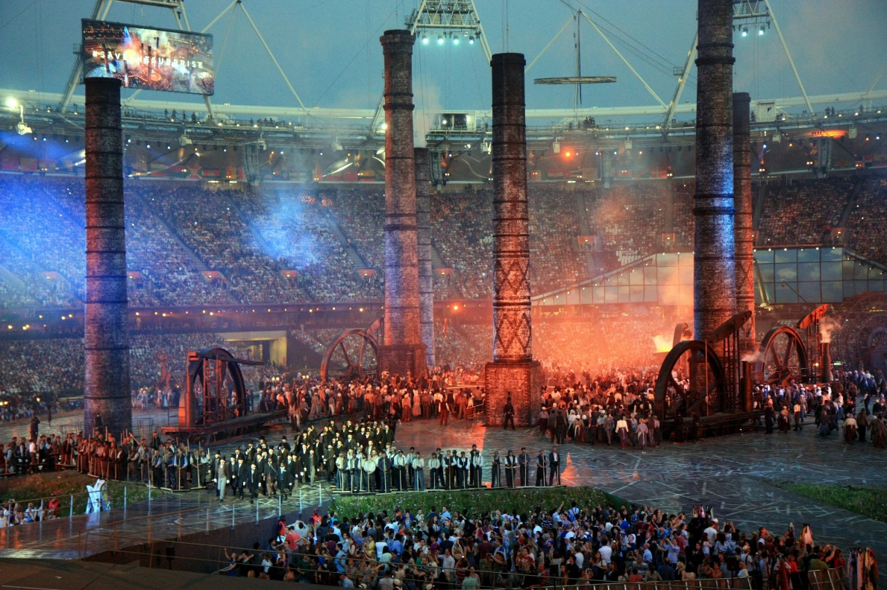
Carefully watch the video and complete the grid with as many observations as you can.
http://www.youtube.com/watch?v=E6NBHx80ovY
Environment | Rich and poor | Industry | Events | Individuals
Notes:
http://www.youtube.com/watch?v=E6NBHx80ovY

Slide 7
What did you see take place?
Environment | Rich and poor | Industry | Events | Individuals
The countryside ‘retreated’ and was replaced with industry. The skyline was dominated by huge factories and chimneys. | Two very distinct classes. Two very different ways of dressing. Two different levels of activity/manual labour. | New wealth Smoke Burning coal Factories Mass production. | Suffrage movement (right to vote) First World War Jarrow March | Brunel (The engineer/industrialist in the top hat) Emily Davidson (The suffragette who is run down by the Kings’ horse)

Slide 8
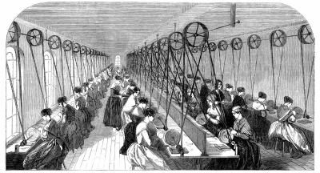
On the following slides (or on your handouts) you will see a series of statements about the Industrial Revolution. Take turns reading them to each other and then discuss what new information you can now add to your tables. Try to get as many new details and facts as you can.

Slide 9
The Industrial Revolution – what was it?
The Industrial Revolution is normally said to have occurred in Britain between 1750 and 1900. It was a period of rapid economic and social change. It was made up of many different factors which all interlinked.
Agriculture. New methods allowed farmers grow much more food than ever before. For example ‘Turnip’ Townshend introduced the Norfolk four-course rotation of farm land and Robert Bakewell used selective breeding to develop the New Leicester sheep.
Industry. New methods of manufacturing using large factories made thousands of basic products like clothes and tools easier to build and cheaper to buy. Richard Arkwright's Mill at Cromford heralded 'the Factory Age' of the textile industry, production of iron increased 30-fold, and production of coal increased 20-fold.

Slide 10
The Industrial Revolution – what was it?
Cities: Hundreds of thousands of families left the countryside and moved to new but often cramped and small houses in the rapidly expanding cities. The skyline became dominated by large chimney and soot and smoke polluted the air.
Transport and communications. Quicker ways of traveling were developed and they changed the world forever. Thomas Telford built roads and canals in the 1700s, and George Stephenson and Isambard Kingdom Brunel oversaw the 'Railway Mania' of the 1800s.

Slide 11
The Industrial Revolution – what was it?
Science and technology: At the same time there occurred a long list of scientific discoveries and technological inventions that changed society and industry.
Society: Women and children began to enter the workforce and receive a salary the relationships that had held societies together began to change. Factory owners often became ‘super rich’ and challenged the old Lords for control over the country.

Slide 12
Describe the key features of the Industrial Revolution
You will need to write three paragraphs to answer this question.
Each paragraph must be about a different factor.
How do we compose paragraphs in History?

Slide 13
Can you rearrange this paragraph into PEEL?
Always PEEL back the question!
For example new transport like canals and the steam train were invented.
The Industrial Revolution was a period of immense change in Britain.
This had huge consequences as it made it much easier to control a large empire and buy and sell things from far away countries.
These were important because they cut down the time it took to travel and to move goods around the country.

Slide 14
Can you rearrange this paragraph into PEEL?
Always PEEL back the question!
The Industrial Revolution was a period of immense change in Britain.
For example new transport like canals and the steam train were invented.
These were important because they cut down the time it took to travel and to move goods around the country.
This had huge consequences as it made it much easier to move raw materials from one part of the world to factories in another part.

Slide 15
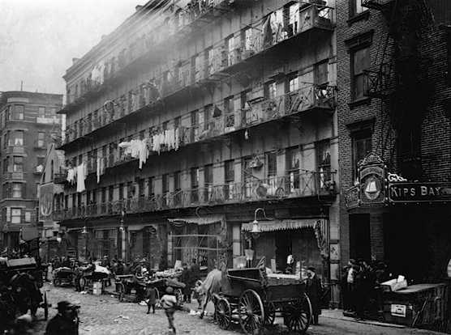
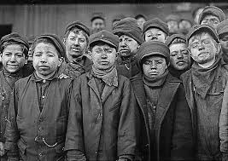
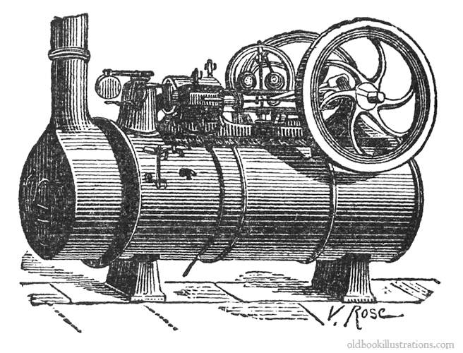
Explain some of the key changes of the Industrial Revolution
Don’t forget to PEEL
You will need to write three paragraphs to answer this question.
Each paragraph must be about a different factor.

Slide 16
Peer Assess
WWW and EBI.
Did they include three paragraphs?
Did they PEEL?
Did they make use of keywords?
How good was their SPAG (Spelling, Punctuation and Grammar?)

Slide 17
Plenary: Add new knowledge to your initial diagram in a different colour
C/W
What did you learn this lesson?

Slide 18
RESOURCES

Slide 19
The Industrial Revolution – what was it? (Handout A)
The Industrial Revolution –
what was it? (Handout B)
The Industrial Revolution is normally said to have occurred in Britain between 1750 and 1900. It was a period of rapid economic and social change. It was made up of many different factors which all interlinked.
Agriculture. New methods allowed farmers grow much more food than ever before. For example ‘Turnip’ Townshend introduced the Norfolk four-course rotation of farm land and Robert Bakewell used selective breeding to develop the New Leicester sheep.
Industry. New methods of manufacturing using large factories made thousands of basic products like clothes and tools easier to build and cheaper to buy. Richard Arkwright's Mill at Cromford heralded 'the Factory Age' of the textile industry, production of iron increased 30-fold, and production of coal increased 20-fold.
Cities: Hundreds of thousands of families left the countryside and moved to new but often cramped and small houses in the rapidly expanding cities. The skyline became dominated by large chimney and soot and smoke polluted the air.
The Industrial Revolution is normally said to have occurred in Britain between 1750 and 1900. It was a period of rapid economic and social change. It was made up of many different factors which all interlinked.
Transport and communications. Faster ways of traveling were developed and they changed the world forever. Thomas Telford built roads and canals in the 1700s, and George Stephenson and Isambard Kingdom Brunel oversaw the 'Railway Mania' of the 1800s.
Science and technology: At the same time there occurred a long list of scientific discoveries and technological inventions that changed society and industry.
Society: Women and children began to enter the workforce and receive a salary the relationships that had held societies together began to change. Factory owners often became ‘super rich’ and challenged the old Lords for control over the country.
Notes:
HIGH

Slide 20
The Industrial Revolution – what was it? (Handout A)
The Industrial Revolution –
what was it? (Handout B)
Agriculture: A farmer called ‘Turnip’ Townshend introduced a new way of growing good that meant more food good be grown on less land.
Industry: Factories made it quicker and cheaper to make new things. A man called Richard Arkwright built a water powered mill that made textiles (clothing) much faster.
Cities: Hundreds of thousands of families left the countryside and moved to new but often cramped and small houses in the rapidly expanding cities. The skyline became dominated by large chimneys and soot and smoke polluted the air.
Transport and communications. Faster ways of traveling were invented. George Stephenson and Isambard Kingdom Brunel helped create the 'Railway Mania' of the 1800s.
Science and technology: There were many scientific discoveries and technological inventions that changed society and industry.
Society: Factory owners often became ‘super rich’ and challenged the old Lords for control over the country.
Notes:
LOW

Slide 21
Environment | Rich and poor | Industry | Events | Individuals

Slide 22
Learning Objectives | Learning episodes |  | Key Words | Resources | Assessment
Identify the key terms of the Industrial Revolution Describe the key changes in the Industrial Revolution. Explain the key changes that occurred during the Industrial Revolution. | 1. Match up key words to definitions and write in books, mind map existing knowledge. 2. Compare the two images, identify the differences between 1750 and 1900. 3. Watch the Olympic video – pupils to describe their observations under the correct categories on the sheet. 4. Information sheets – pairs take it in turns to read the information while describing additional information on their category sheet. 5: Pupils to be reminded of PEE(L) and talk through the example before attempting their own PEE(L) paragraphs to explain |  | Industrial Revoluition Raw MAterials Manufacturing | PowerPoint: X>Hums>History>Resources>Year 8> Ind Rev>Lesson 1>Intro.ppt Table of factors (for video and notes) and the notes themselves are all on the PowerPoint and can be printed if required/desierable. | Peer assessment. paired work Group work verbal and written responses
Differentiation |  | Differentiated handouts for SEN
Literacy Opportunities |  | SPAG PEE(L),
Numeracy Opportunities |  | -
SMSC Opportunities |  | -
Homework |  | -

Slide 23
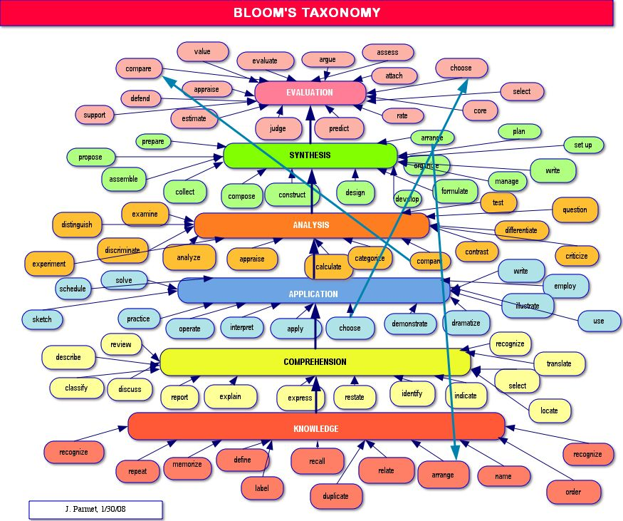

Slide 24
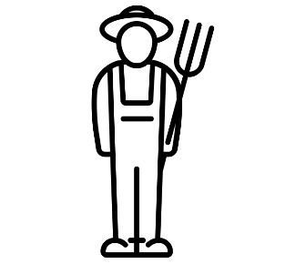
EAL ASSISSTANCE SHEET
1. Can you match the words to the correct image?
Sheep
Farmer
Factory
Challenge: Write a paragraph using all of the words above. Make sure it makes sense!

Slide 25
Industrial Revolution SOW
# | 1 | 2 | 3 | 4 | 5 | 6 | 7
Title | Intro to Industrial Revolution | Population Boom | Factories | Coal Mining | Transport | Robert Stephenson | Industrial Revolution Inventions
Overview | Olympics Video – Key words – Focus on change. | Think/Pair/Share - Group work - Time travel writing task | Summary task - Group Relay Activity - PEEL paragraphs | Literacy Task - Source Analysis - Structured written task. | Summary task - Teach roulette - Grid questioning | Quiz/Quiz/Trade - Group Thinking - Modelled paragraph | Justification Task & Morse Code – Group Research Task – Dragon’s Den Presentations.
All available at the Wolsey Academy TES Shop

Slide 26
Industrial Revolution SOW
# | 8 | 9 | 10 | 11 | 12 | 13 | 14
Title | Child Labour | Public Health Problems | Public Health & Government | Public Health Source Q | Luddites | Empire | Empire: Source Question
Overview | Note Taking - Source Analysis - Structured Writing Task | Reading Task - Creative Writing Task - Hot seating | Source Categorising Task - Group Discussions - PEEKA Paragraph Writing Task | Reading Task - Exam Q On Source - Peer Assess | Class Discussions - Round The Room Research Task - Categorisation Task. | Video Note Taking - Categorisation Task - Structured Writing Task | Analysis Of Exemplar - 3 Source Cross Reference - Written answer.
All available at the Wolsey Academy TES Shop

